Slide 1
Homeroom Do Now 9/15/2020
Write 1 paragraph to define honesty and to explain why it is important in a friendship.

Slide 2
Science Warm Up 9/15/2020
All of the following are physical properties except ____________.
a. color c. melting
b. density d. flammability

Slide 3
Weekly Homework
Textbook pages 66-73

Slide 4
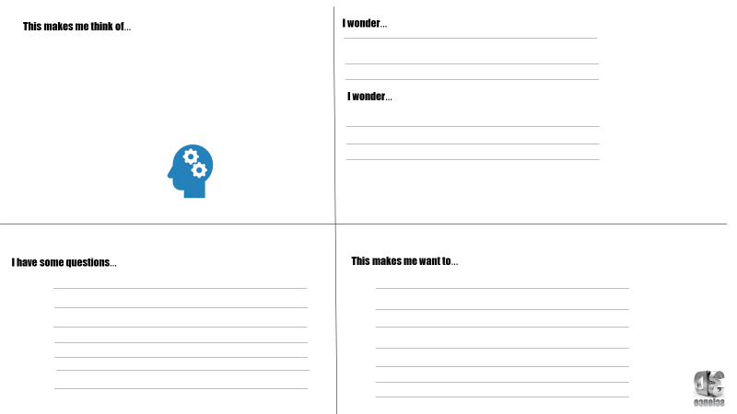
Use ½ entire page in your notebook to draw this chart and all words.

Slide 6
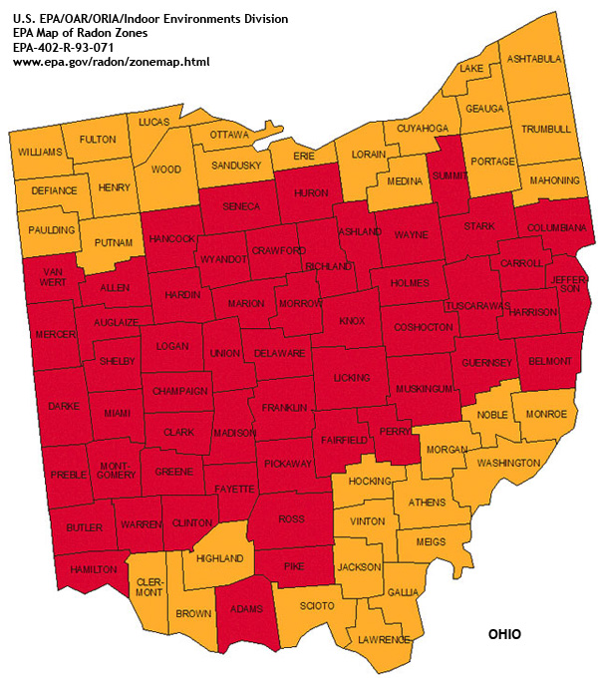
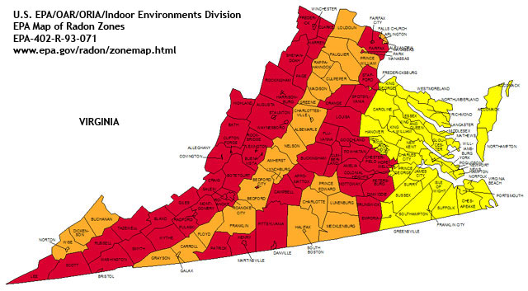
States of Matter
STATES
OF
MATTER

Slide 7
STATES OF MATTER
The Four States of Matter
Four States
Solid
Liquid
Gas
Plasma

Slide 8
STATES OF MATTER
Based upon particle arrangement
Based upon energy of particles
Based upon distance between particles

Slide 9
Kinetic Theory of Matter
Matter is made up of particles which are in continual random motion.

Slide 10
STATES OF MATTER SOLIDS
Particles of solids are tightly packed, vibrating about a fixed position.
Solids have a definite shape and a definite volume.
Heat

Slide 11
STATES OF MATTER LIQUID
Particles of liquids are tightly packed, but are far enough apart to slide over one another.
Liquids have an indefinite shape and a definite volume.
Heat

Slide 12
STATES OF MATTER GAS
Particles of gases are very far apart and move freely.
Gases have an indefinite shape and an indefinite volume.
Heat

Slide 13
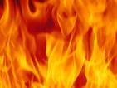
But what happens if you raise the temperature to super-high levels… between 1000°C and 1,000,000,000°C ?
Will everything just be a gas?

Slide 14
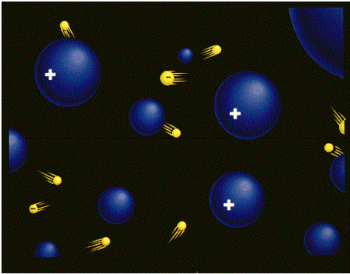
STATES OF MATTER PLASMA
A plasma is an ionized gas.
A plasma is a very good conductor of electricity and is affected by magnetic fields.
Plasmas, like gases have an indefinite shape and an indefinite volume.
Plasma is the
common state
of matter

Slide 15
STATES OF MATTER
SOLID
LIQUID
GAS
PLASMA
Tightly packed, in a regular pattern
Vibrate, but do not move from place to place
Close together with no regular arrangement.
Vibrate, move about, and slide past each other
Well separated with no regular arrangement.
Vibrate and move freely at high speeds
Has no definite volume or shape and is composed of electrical charged particles

Slide 16
Some places where plasmas are found…
1. Flames

Slide 17
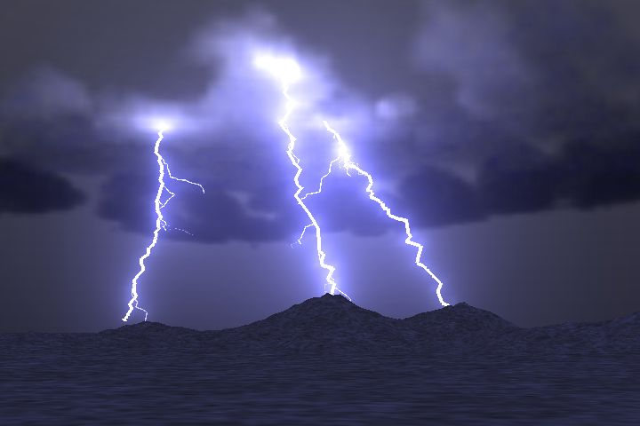
2. Lightning

Slide 18
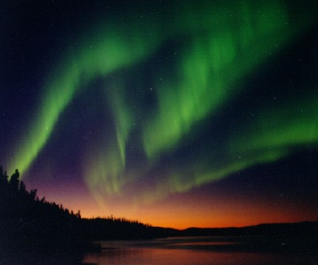
3. Aurora (Northern Lights)

Slide 19
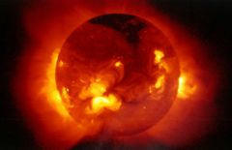
The Sun is an example of a star in its plasma state

Slide 20
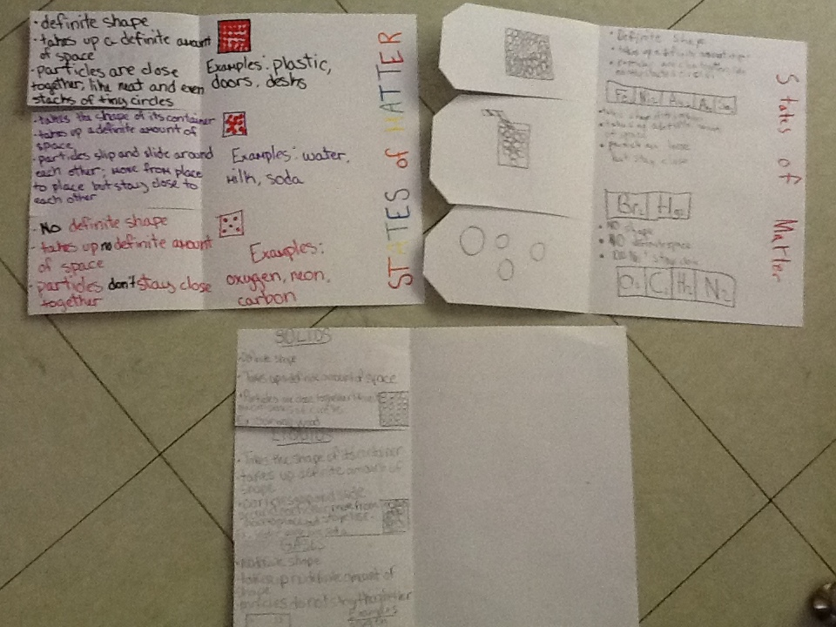
Assignment States of Matter Foldable
Must include Solid, Liquids, Gas. Definition, picture of particle arrangement and 3 examples. See examples below

Slide 21
Review Questions
What state of matter has definite volume and definite shape?
Describe the properties of liquids.
Describe the differences between gases and plasma.

Slide 22
Science Closure 9/15/2020
The following illustration shows three different states of a substance. Which of the following happens when the substance in jar B changes state to the substance in jar A?
A. The particles vibrate faster.
B. The mass of the substance increases.
C. The identity of the substance changes.
D. The particles expand to fill their container.

