Slide 1
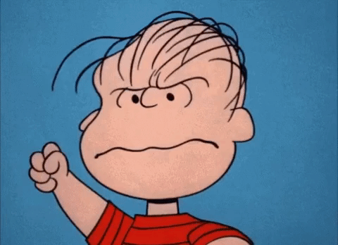
Homeroom Warm Up 1/27/2020
Did you ever take up for someone or has someone ever taken up for you? Write about what happened.

Slide 2
Science Warm Up 1/27/2020
Diagrams of plant cell division are shown out of order below. What is the correct sequence of plant cell division? In addition be sure to name each stage.
A. 3, 2, 5, 1, 4
B. 4, 3, 2, 1, 5
C. 3, 4, 5, 1, 2
D. 5, 1, 2, 4, 3

Slide 3
Take a look at the picture below and complete the following sentences with your own responses
1. This makes me think of….
2. I wonder….
3. I have some questions….
4. This makes me want to….

Slide 4
Sexual vs. Asexual Reproduction
Compare and contrast the fundamental features of sexual and asexual reproduction.
Objective→ I can identify and compare the processes of sexual and asexual reproduction.

Slide 5
Homework
Textbook pages 282-289 due this Friday

Slide 6
Reproduction
Reproduction is necessary for the continuation of every species.
Every organism alive today comes from a long line of ancestors who reproduced successfully every generation. Reproduction is the transfer of genetic information from one generation to the next. It can occur with mixing of genes from two individuals (sexual reproduction). It can occur with the transfer of genes from one individual to the next generation (asexual reproduction). The ability to reproduce defines living things.

Slide 7
Sexual Reproduction
A type of reproduction in which the genetic materials from two different cells combine, producing an offspring
The cells that combine are called sex cells (gametes)
Female – egg
Male – sperm
Fertilization: an egg cell and a sperm cell join together
A new cell is formed and is called a zygote

Slide 8
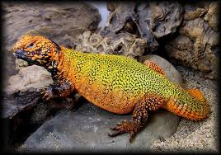
Advantages: Sexual Reproduction
Diverse offspring: genetic variation among offspring
Half of the DNA comes from mom
Half of the DNA comes from dad
Due to genetic variation, individuals within a population have slight differences
Plants – resist diseases
Traits can develop to resist harsh environments that allows an organism survive

Slide 9
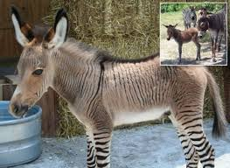
Advantages: Sexual Reproduction
Selective Breeding
Used to develop many types of plants and animals that have desirable traits
Agriculture/Farming: better plants, larger animals
Desirable pets

Slide 10
Disadvantages: Sexual Reproduction
Time and Energy
Organisms have to grow and develop until they are old enough to produce sex cells
Search and find a mate
Searching can expose individuals to predators, diseases, or harsh environmental conditions

Slide 11
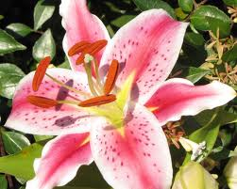
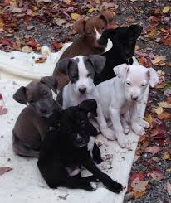
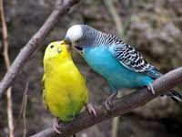
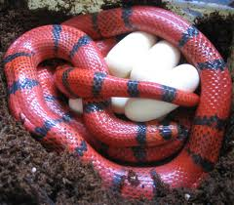
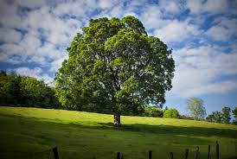
Examples: Sexual Reproduction

Slide 12
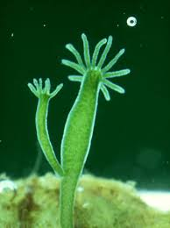
Asexual Reproduction
One parent: organism produces offspring without fertilization
Uniform offspring:
Because offspring inherit all of their DNA from one parent, they are genetically identical to each other and to their parent

Slide 13
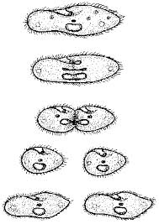
Binary Fission: Asexual Reproduction
Fission: Cell division in prokaryotes that forms two genetically identical cells
DNA is copied
The cell begins to grow longer, pulling the two copies apart
The cell membrane pinches inward in the middle of the cell
Cell splits to form two new uniform, identical offspring
Examples: bacteria, Ecoli, pond critters

Slide 14
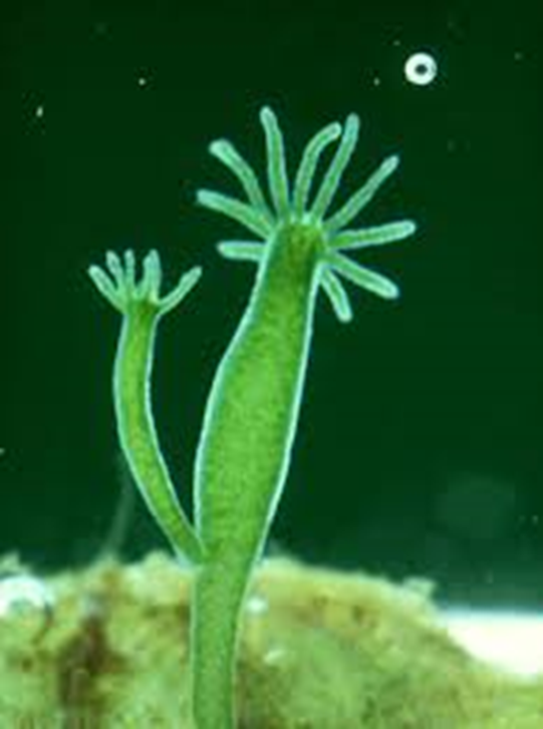
Budding: Asexual Reproduction
Budding: a new organism grows by mitosis and cell division on the body of its parent
The bud, or offspring is identical to the parent
The bud, when large enough, can break off of the parent and live on its own
Offspring may remain attached and form a colony
Examples: Yeast, Hydra, cactus

Slide 15
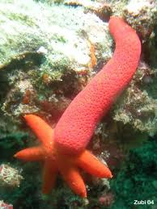
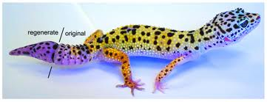
Regeneration: Asexual Reproduction
Regeneration: occurs when an offspring grows from a piece of its parent.
Producing new organisms: Sea Stars
Sea urchins, sea cucumber, sponges, and planarians
Producing new body parts: Gecko

Slide 16
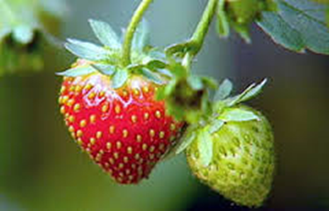
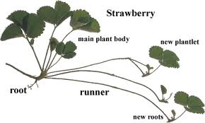
Vegetative Propagation: Asexual
Vegetative Propagation: uniform offspring grow from a part of a parent plant
Parent plants sends out runners
Where the runner touches the ground, roots can grow
A new plant is produced even if the runner is broken apart
Each new plant is uniform and identical to the parent.
Examples: strawberries, potatoes, ivy, crabgrass

Slide 17
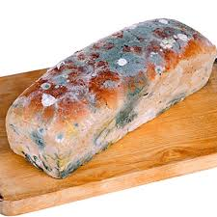
Advantages: Asexual Reproduction
Enables organisms to reproduce without a mate
No wasted time and energy
Enables some organisms to rapidly reproduce a large number of uniform offspring

Slide 18
Disadvantages: Asexual Reproduction
Because their offspring are identical, there is no genetic variation that can give an organism a better chance for survival
Example: If a weed killer can kill the parent, it will also kill the offspring
A whole species can be wiped out from a disease
Dangerous mutations in DNA – if the parent has the mutation in their DNA, the offspring will have it too.

Slide 19
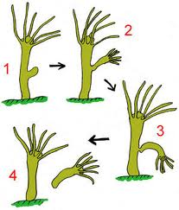
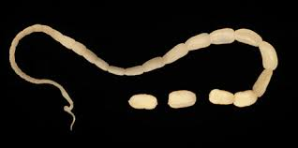
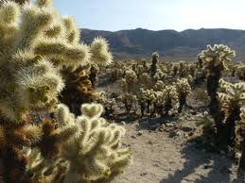
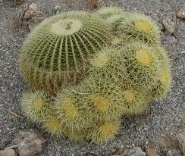
Examples: Asexual Reproduction

Slide 20
Activity:
Create a creature that reproduces asexually.
Draw the creature
Describe how the creature reproduces asexually
Describe 1 advantage of reproducing this way
Describe 1 disadvantage of reproducing this way
Name your creature

Slide 21
Science Closure 1/27/2020
The diagrams represent the way that three different organisms reproduce. Which of these classifies the reproductive method of all the organisms shown above?
A segmentation
B budding
C asexual reproduction
D sexual reproduction

