Slide 1
Homeroom Warm Up
If you could end any one problem in the world, what would it be? Why?

Slide 2
Science Warm Up 11/17/2020
Which of the following occurrences indicates that a chemical reaction has taken place?
A. An odor is produced by burning a sugar cube.
B. A puddle is produced by melting an ice cube.
C. A loud noise is produced by crushing a can.
D. A piece of glass is produced by breaking a bottle.

Slide 3
Agenda
Review Objective
Intro to Chemical Reactions (Notes part 2)
Video
Closure

Slide 4
Science Warm Up 11/15/2020
A magnet was placed near a pile that contained both iron and sulfur. The magnet was moved gradually closer to the pile. As it neared the pile, the magnet started attracting small pieces of iron from the pile. Which of these statements best describes the contents of the pile?
It is a homogeneous mixture of iron and sulfur.
It is a heterogeneous mixture of iron and sulfur.
It is a compound that contains both iron and sulfur.
It is a compound that can be separated by magnetism.

Slide 5
Take a look at the picture below and complete the following sentences with your own responses
1. This makes me think of….
2. I wonder….
3. I have some questions….
4. This makes me want to….

Slide 6
The process in which atoms are rearranged and chemical bonds are broken & formed to produce a chemical change of a substance.
examine in detail
explain the meaning
TSWBAT analyze and interpret chemical reactions in order to determine if the total number of atoms in the reactants and products support the Law of Conservation of Mass.
A substance that participates in a chemical reaction.
to decide
A substance that forms in a chemical reaction.
Mass can not be created or destroyed in ordinary chemical or physical changes.

Slide 7
Vocabulary Terms Define for Homework tonight!
1. chemical reaction
2. chemical formula
3. exothermic reaction
4. endothermic reaction
5. reactant
6. law of conservation of energy
7. product
8. law of conservation of mass

Slide 8
Chemical Reaction- The process in which atoms are rearranged and chemical bonds are broken & formed to produce a chemical change of a substance.
Chemical Formula- a combination of chemical symbols and numbers to represent a substance.
Reactant-A substance that participates in a chemical reaction.
Product- A substance that forms in a chemical reaction.
Law of Conservation of Mass-Mass can not be created or destroyed in ordinary chemical or physical changes.
Endothermic reaction- A chemical reaction that requires energy input.
Exothermic reaction- A chemical reaction in which energy is released to the surroundings.
Law of Conservation of Energy- Energy can not be created or destroyed but can be changed from one form to another.

Slide 9
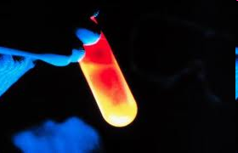
Chemical Reactions
7.PS1.4 Analyze and interpret chemical reactions to determine if the total number of atoms in the reactants and products support the Law of Conservation of Mass.

Slide 10
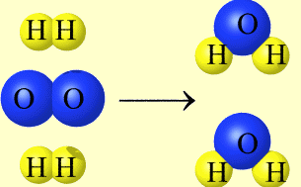
What is a Chemical Reaction?
It is a chemical change in which one or more substances are destroyed and one or more new substances are created.
BEFORE
H₂ gas
and
O₂ gas
AFTER
H₂O liquid

Slide 11
Chemical Reactions are Everywhere
Cooking
Respiration

Slide 12
Chemical Reactions are Everywhere
Hair Dye
Auto Fuel

Slide 13
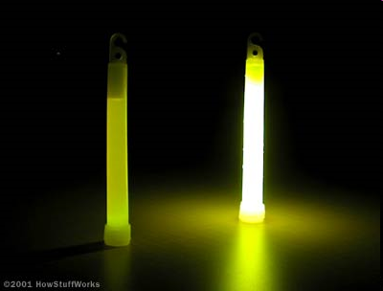
Evidence for a Chemical Reaction
1) Change in light or heat.

Slide 14
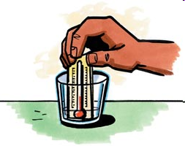
Evidence for a Chemical Reaction
2) Temperature change (increase or decrease) to the surroundings.

Slide 15
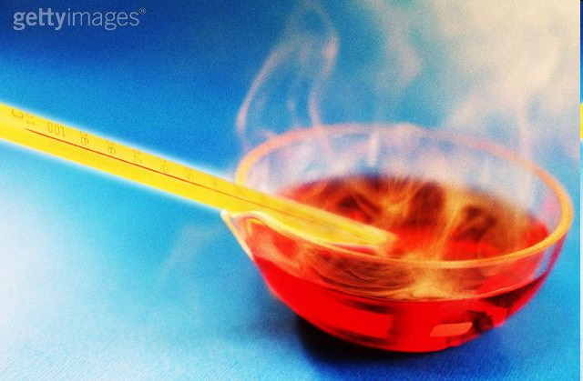
Evidence for a Chemical Reaction
3) Formation of a gas (bubbling or an odor) other than boiling.

Slide 16
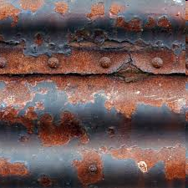
Evidence for a Chemical Reaction
4) Color change (due to the formation of a new substance).

Slide 17
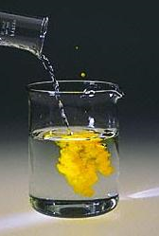
Evidence for a Chemical Reaction
5) Formation of a precipitate (a new solid forms) from the reaction of two liquid solutions.

Slide 18
Observing chemical Reactions
Changes in Energy:
ENDOTHERMIC- reactions that take in energy (decrease in temperature)
EXOTHERMIC- reactions that give off energy (increase in temperature)
Video

Slide 19
Test Retake Time

Slide 20
Observing chemical Reactions
Changes in Energy:
Some reactions ABSORB energy
Other reactions RELEASE energy
You can usually tell if something is absorbing or releasing energy because there is a CHANGE IN TEMPERATURE.

Slide 21
Science Closure 11/15/2020
Which of the following occurrences indicates that a chemical reaction has taken place?
A. An odor is produced by burning a sugar cube.
B. A puddle is produced by melting an ice cube.
C. A loud noise is produced by crushing a can.
D. A piece of glass is produced by breaking a bottle.

