Slide 1
Weekly Enrichment Activities Week of 5/11/20
Read notes on Climate Change and Global Warming included in this ppt
Watch video on Climate Change on BrainPOP. Also answer the quiz questions for the video.
Define vocabulary terms listed on Science textbook page 483.
Read and complete Science textbook pages 482-499.
Log in to Clever through Edugoodies. Scroll down and then click on Discovery Education. Once you have logged in you will be able to view video lesson I assigned titled Human Impact on Earth's Systems and Global Warming
See next slide for Legends of Learning Science Games’ details
Have a great week!

Slide 2
Legends of Learning
To access this assignment, students should go to login.legendsoflearning.com Between: 05-11-2020 and 05-22-2020 Then, enter your teacher code when prompted: STANFO18 and click the assignment named: "Assignment - Playlist - Warm Planet Adventure"

Slide 3
Climate Change and Global Warming
What is it?
What causes it?
What are the effects?

Slide 4
The sun heats our planet in a naturally occurring process.
But, is Earth getting warmer than it was in the past?
Are humans contributing to climate change?

Slide 5
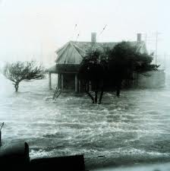
Global Warming?
Climate Change?
This is because our planet may be getting warmer.
Climate change is sometimes called ‘Global Warming’.
Higher global temperatures can cause changes in our climate such as more or less precipitation, and more severe storms.

Slide 6
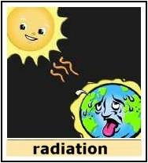
What Might Cause Climate Change?
First, we have to understand a little background about the climate on our planet.
The Greenhouse Effect is the reason that temperatures on the surface of the Earth allow life to exist.

Slide 7
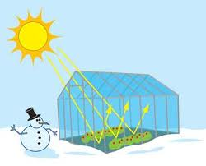
What it the Greenhouse Effect?
The sun’s radiant energy warms the Earth, just like the Sun warms a greenhouse.
A greenhouse is a glass building that lets in the sun’s heat. The glass walls and ceiling prevent or slow the escape of this heat back into the atmosphere.

Slide 8
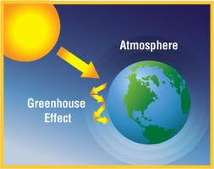
The Greenhouse Effect
The Earth’s ATMOSPHERE acts like the glass of the greenhouse, letting the heat in, keeping much of it at the surface of the Earth and not letting all of it radiate back into space.

Slide 9
What Makes Up Our Atmosphere?
Many kinds of gases make up our atmosphere which help hold the sun’s heat close to the surface.
About 78% of our atmosphere consists of nitrogen gas, and about 21% is oxygen gas. Many other gases are in small amounts such as argon, carbon dioxide, methane, and ozone.

Slide 10
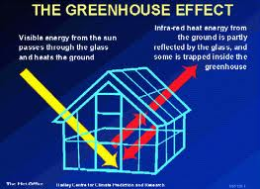
Greenhouse Gases
Some gases in the atmosphere are called ‘Greenhouse’ gases because they act like the glass in a greenhouse.
They especially retain the heat that would normally radiate back out to space at night.

Slide 11
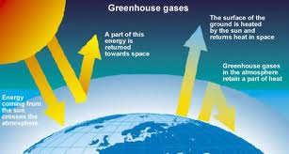
Greenhouse Gases
Some GREENHOUSE GASES are: water vapor, carbon dioxide, methane, ozone, and nitrous oxide.
Remember that gases are matter, and are composed of atoms.

Slide 12
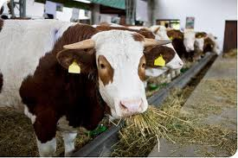
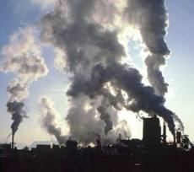
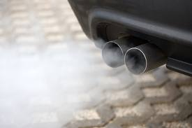
Greenhouse Gases
Certain human activities can add to the amount of these gases in the air, often called ‘particulates’.
For instance: burning fossil fuels, burning wood, decomposing organic wastes, agricultural and industrial activities.

Slide 13
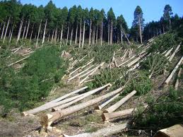
Making Connections
Studies of ancient climates show that an increase of Earth’s temperatures follows an increase in atmospheric carbon dioxide.
Carbon dioxide levels in the atmosphere have been increasing rapidly since the 1950’s.
The CO₂ increase has been connected to the burning of fossil fuels and to deforestation.

Slide 14
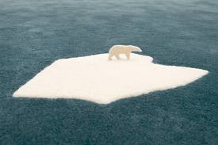
Making Connections
Based on climatologists’ estimates, it is believed that Earth’s average temperature has increased 0.9 degrees Celcius, or 1.62 degrees Farenheit between 1860 and 2000.

Slide 15
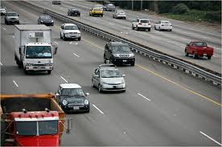
Global Warming and The Greenhouse Effect
If we increase the amount of gases in our atmosphere, there will be more matter to absorb and retain the heat.
It is believed this is exactly what we are doing – creating and releasing more greenhouse gases into the atmosphere through our everyday activities.

Slide 16
Global Warming and The Greenhouse Effect
So, what’s the connection between Global Warming and the Greenhouse Effect?
Humans are adding to the levels of greenhouse gases.
Greenhouse gases can absorb and retain the Sun’s heat.
More heat in the atmosphere means higher global temperatures.

Slide 17
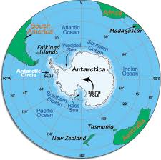
What are the likely effects of
these higher temperatures?
Sea levels may rise anywhere from 7 – 23 inches over the next hundred years or so.
This may be due to the melting of mountain glaciers and ice sheets of Greenland and Antarctica.

Slide 18
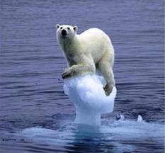
Likely Effects
Arctic sea ice is fresh water – it is less dense and may cause changes in deep ocean currents.
Less sea ice may also mean higher sea temperatures because water absorbs more of the sun’s energy than the ice would.

Slide 19
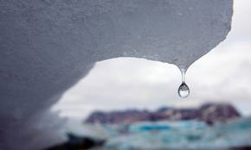
Adding to the increased rate of the melting Arctic ice…
… is the fact that particulates in the atmosphere fall out of the air onto the ice. The particulates absorb more heat and cause melting of the ice underneath.

Slide 20
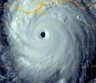
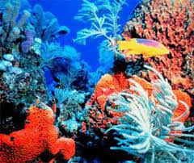
If Ocean Temperatures Rise…
Warmer oceans may also cause coral reefs to die.
It can trigger stronger hurricanes.

Slide 21
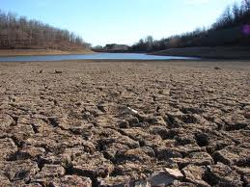
Warmer Ocean Temperatures Affect…
…the climate on the land.
Warmer temperatures mean more evaporation in some areas…

Slide 22
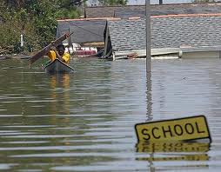
And…
…more flooding in other areas.
Temperatures may be extreme – colder winters, hotter summers.
Summer heat waves may last longer, hurricane season may be longer, droughts may be more severe and last longer.

Slide 23
Can we do anything about Global Warming and Climate Change?
Yes!!!

Slide 24
What can we do about Global Warming and Climate Change?
You can put less carbon dioxide into the atmosphere!
Use mass transportation
Drive less
Increase the use of renewable resources
Reduce, reuse, recycle
Plant more trees
Use less energy in your home

Slide 25
What can be done about Global Warming and Climate Change?
Business, industry, and the world’s governments can work together to clean our air, keep it clean, and continue their investigations so we can better understand the connections between human activities and atmospheric changes, and make a positive difference for our future.

Slide 26
Review
1. Greenhouse gases, such as ____________ and ____________ absorb and retain the sun’s heat.
2. More retained heat causes Earth’s surface temperatures to __________.
3. __________ are adding to the amount of greenhouse gases in the atmosphere.
4. Global warming is connected to an increase in ______________ in the atmosphere.
5. Global warming can cause ________ change.

Slide 27
Review Answers
1. Greenhouse gases, such as carbon dioxide and methane absorb and retain the sun’s heat.
2. More retained heat causes Earth’s surface temperatures to rise.
3. Humans are adding to the amount of greenhouse gases in the atmosphere.
4. Global warming is connected to an increase in greenhouse gases in the atmosphere.
5. Global warming can cause climate change.

Slide 28
For further Research:
http://www.climatechangeeducation.org/
http://globalwarmingkids.net/
http://www.education.noaa.gov/sclimate.html

Slide 29
