Slide 1

Homeroom Warm Up
4/5/2021
Which of the following body systems is responsible for receiving stimuli from the environment and coordinating the body's response to these stimuli?
respiratory system
nervous system
digestive system
circulatory system

Slide 2

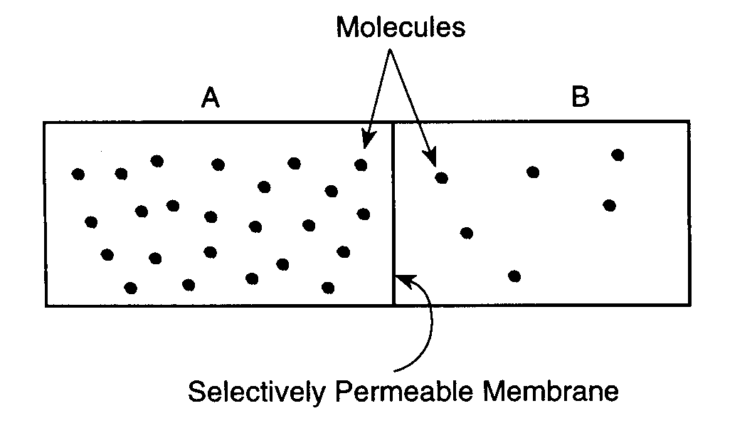
Science Warm Up
4/5/2021
The diagram shows carbon dioxide molecules in area A and area B. With the passage of time, some carbon dioxide will move from
A. side B to side A through simple diffusion.
B. side A to side B through simple diffusion.
C. side A to side B through active transport.
D. side A to side B through osmosis.

Slide 3

Agenda
New Phenomenon
Introduce new Objective/Word Wall
Heredity Notes
Practice (I do, we do, you do)
Video* time permits
Closure

Slide 4
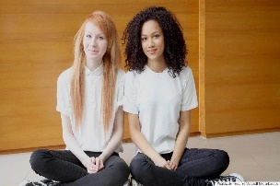
Take a look at the picture below, the two girls pictured are twins. Now complete the following sentences with your own responses
1. This makes me think of….
2. I wonder….
3. I have some questions….
4. This makes me want to….

Slide 5
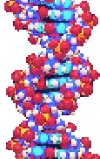
Heredity

Slide 6






To pass something
To foretell on the basis of observation observation,
the chance that a given event will occur
TSWBAT predict the probability of individual dominant and recessive alleles to be transmitted from each parent to offspring during sexual reproduction IOT represent the genotypic and phenotypic patterns using ratios.
the relationship in quantity, amount, or size between two or more things

Slide 7
Genetics Word Wall
Dominant traits- traits that are expressed.
Recessive traits- traits that are covered up.
Alleles- the different forms of a characteristic.
Punnett Squares- show how crosses are made.
Probability- the chances/ percentages that something will occur.
Genotype- the types of genes (Alleles) present.
Phenotype- what it looks like.
Homozygous- two of the same alleles.
Heterozygous- two different alleles.

Slide 8
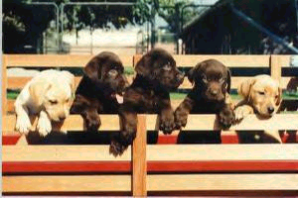
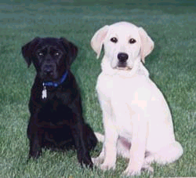
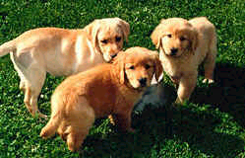
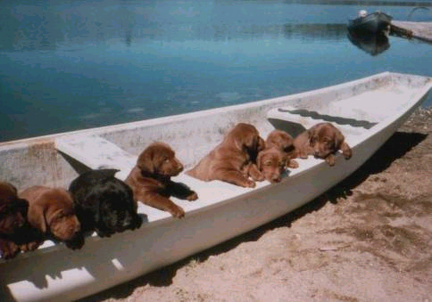
Genetics is the study of heredity, how traits are passed from parent to offspring
or
x
=
or

Slide 9

Heredity: the passing of traits from parents to offspring (kids)
  Can be complicated
    Ex: Why does your brother have different features than you?
Gregor Mendel: father of genetics
  Austrian Monk
  Worked with flowers at monastery
    Noticed patterns in flower traits & people
    Studied garden peas

Slide 10
What is a trait?
A genetically determined characteristic or condition
Eye Color
Hair Color
Height
Weight
Body Structure
Facial Features
Skin Color

Slide 11
How are traits passed on?
Each parent has two genes (or letters) for a trait. These letters are called alleles.
Capital letters are called Dominant alleles. When these alleles are present, they take over or show. They are the stronger alleles
Lower case letter are recessive alleles and are the weaker of the alleles.

Slide 12
Dominant trait: trait that appears
  Only requires one of the traits to show
  Dominant B- brown eyes, T -tall, C- curly hair, W -widows peak, F- freckles, D- dark skin
Recessive trait: trait that hides in the background (genetic code)
  Only appears when there’s two of them
  Recessive b- blue eyes, t -short, s -straight hair, w -no widows peak, f -no freckles, d -light skin

Slide 13
Genes: pieces of DNA that carry hereditary information on them
  Are passed from parents to offspring, located on chromosomes

Slide 14
Genotype: inherited combination of alleles
  Actual genes
    Bb, Ll
Phenotype: the organism’s appearance
  What it looks like
    Blue eyes, brown hair

Slide 15
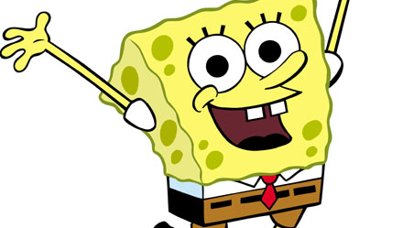
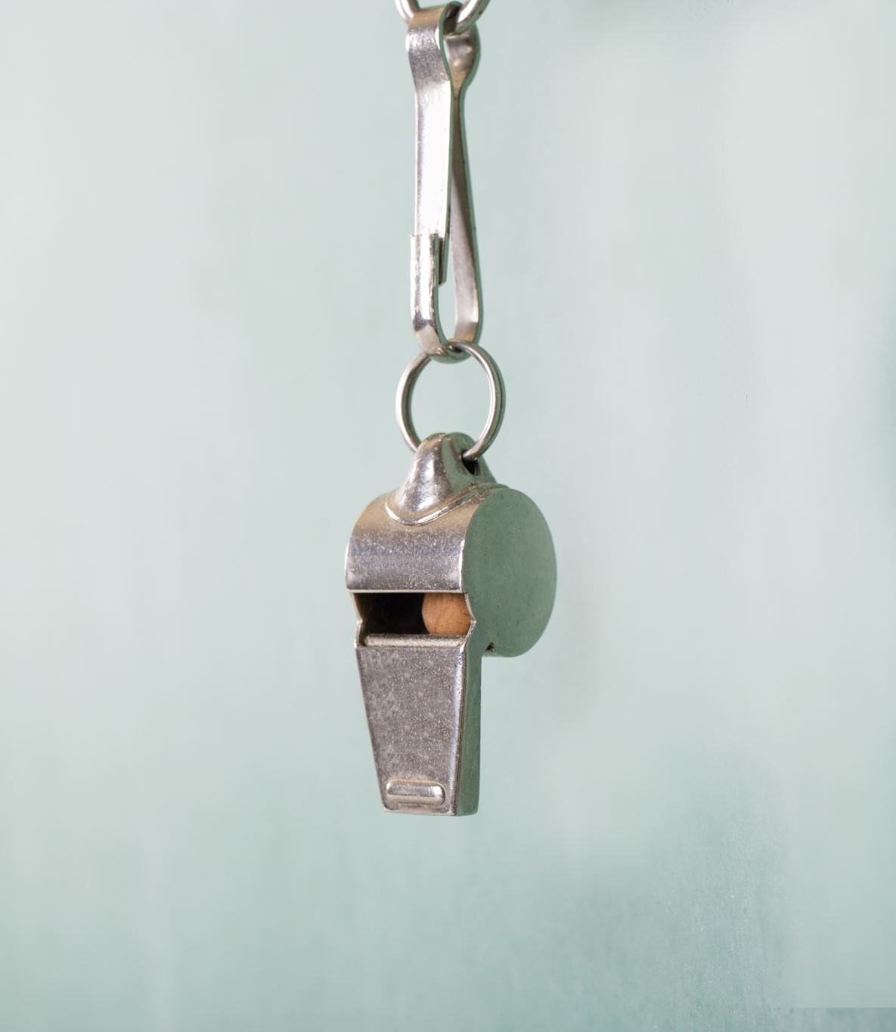
Let’s Practice

Slide 16
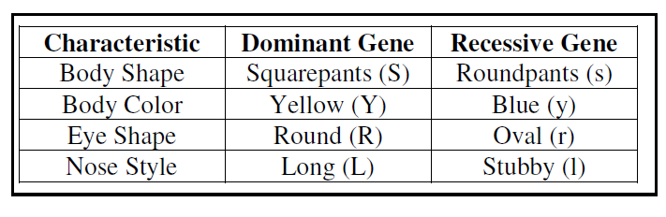
Use the information for SpongeBob’s traits to write the phenotype (physical appearance) for each item.
(a) LL-______________ (e) Rr-_______________
(b) yy-_______________ (f) ll- _______________
(c) Ss-_______________ (g) ss- _______________
(d) RR - _____________ (h) Yy -______________

Slide 17
Use the information for SpongeBob’s traits to write the phenotype (physical appearance) for each item.
(a) LL- long nose (e) Rr- Round Eye
(b) yy- Blue body (f) ll- stubby nose
(c) Ss- squarepants (g) ss- roundpants
(d) RR – round eye (h) Yy - yellow body

Slide 18
Purebred: both genes are alike
  Also called homozygous
  bb, TT, DD
Hybrid: genes are different
  Also called heterozygous
  Bb, Tt, Dd

Slide 19
Punnett Square
Square used to visually show all possible gene combinations

Slide 20
Tall Plant (Tt) X Short Plant (tt)
T
t
50 % Tall
50 % Short
t
Tt
tt
t
Tt
tt

Slide 21
Tall Plant (TT) X Short Plant (tt)
T
T
100 % Tall
0 % Short`
t
Tt
Tt
t
Tt
Tt

Slide 22
Incomplete Dominance
If one trait is incompletely dominant over another then the hybrid genotype would yield a new phenotype.
For example, in snapdragons, red flowers are incompletely dominant over white. The hybrid is pink.
So the genotype RR would yield red flowers, WW would yield white flowers, and RW or WR would yield pink flowers.

Slide 23
Probability: chance that an event will occur
  After solving Punnett squares, questions will often ask you to predict the probability of one of the traits.
  Ex: What’s the chance of a child having blue eyes? Expressed like so:
  0%, 25%, 50%, 75%, or 100%
  (0/4) (1/4) (2/4) (3/4) (4/4)

Slide 24
Mendelian Genetics
Dominant traits- traits that are expressed.
Recessive traits- traits that are covered up.
Alleles- the different forms of a characteristic.
Punnett Squares- show how crosses are made.
Probability- the chances/ percentages that something will occur.
Genotype- the types of genes (Alleles) present.
Phenotype- what it looks like.
Homozygous- two of the same alleles.
Heterozygous- two different alleles.

Slide 25
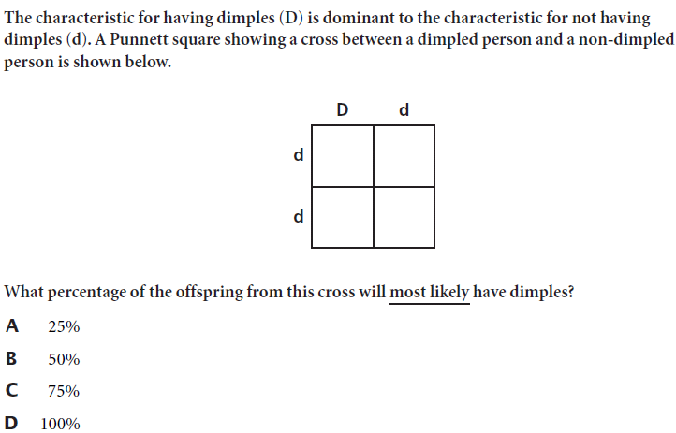
Science Closure
4/5/2021

