Slide 1

Homeroom Do Now
8/14/18
If you are like most people, you probably have had experiences in which you have been treated in a way you consider unfair. Write about a time when you feel you were treated unfairly, and if you’ve never experienced write about a time you feel someone else was treated unfair.
*write at least 1 paragraph and be prepared to share

Slide 2
Homeroom Warm Up
8/14/17 write 3-5 sentences on this topic
Finish this thought: if I could change one thing about myself (if you can't think of anything, you might want to consider telling how you got to be perfect!)

Slide 3
Science Warm Up
8/14/18
A student hypothesized that a mouse would learn to run through a maze faster if food was at the end of the maze. Which tool will best help the student determine if the speed of the mouse improved?
A metric ruler
B pan balance
C stopwatch
D spring scale

Slide 4

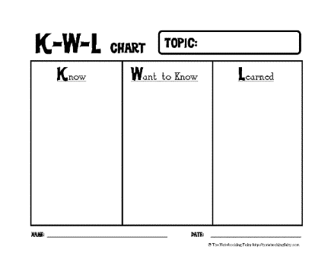
DO NOW
8/14/18
What do you know about “Matter”? Create a K/W/L chart (complete columns “K” and “W” only).
What do you know about “Matter”? Create a K/W/L chart (complete columns “K” and “W” only).

Slide 5

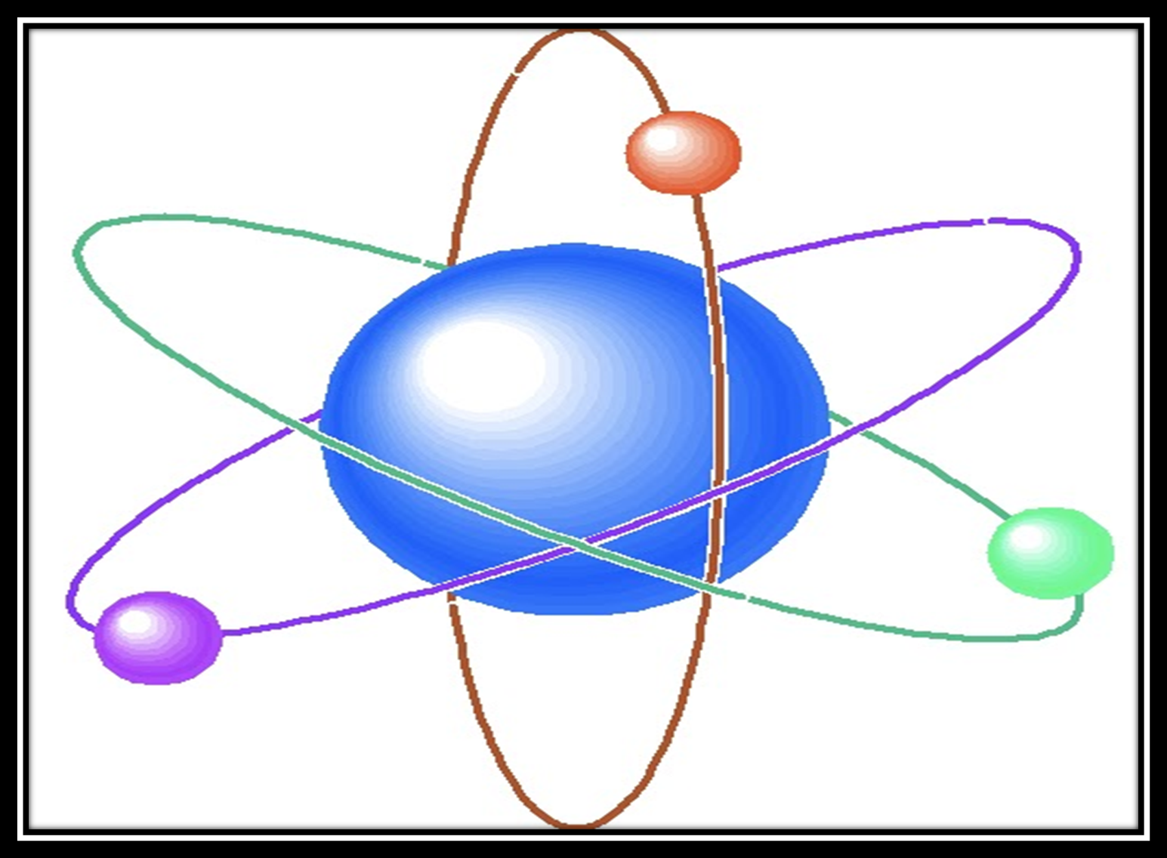

By: Cammie’s Corner
By: Cammie’s Corner

Slide 6

Matter
Matter: anything that has mass and takes up space.
Examples: Everything around you is matter, you are matter, the air is matter

Slide 7
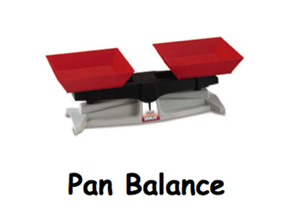
Mass
Mass: the amount of matter or stuff in an object.
Measured in grams and kilograms
Ex. Paper clip has a mass of about 1 gram, a liter of milk has a mass of about 1 kilogram.
You can measure mass with a balance.
The mass of an object is the same everywhere in the universe.
http://pbskids.org/cyberchase/math-games/poddle-weigh-in/

Slide 8
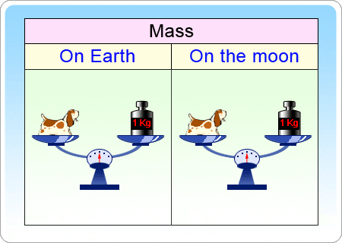

Slide 9

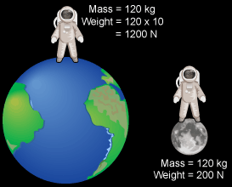
Weight
Weight: a measure of the pull of gravity on an object’s mass.
Because of gravity, weight is NOT the same everywhere in the universe. (on the moon you would weigh less than Earth).

Slide 10
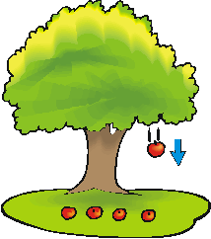
Gravity is a force of attraction between two objects. All objects with mass have gravity. Gravity acts like a magnet - pulling objects together.

Slide 11


The Mass of an Object and Its Parts
The mass of an object = the total mass of it parts
Ex. You have 5 wooded blocks that are all the same. You use a balance and to measure 1 block. It is 25 grams.
The mass of the all 5 would be
25 g
25 x 5 = 125 g.

Slide 12
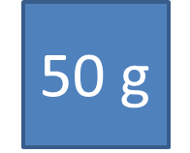
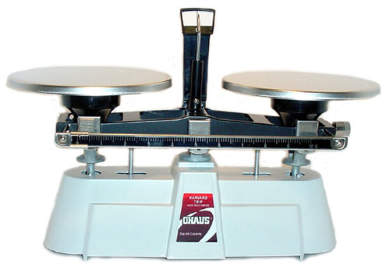
ex. You have 2 puzzles. Each has a mass of 200 grams.
You place a finished puzzle in on pan of a balance.
Then you take the other puzzle apart and put its pieces in the other pan. Which puzzle has the greater mass?
50 g
200 g
The puzzles have the same mass whether they are put together or in pieces.

Slide 13

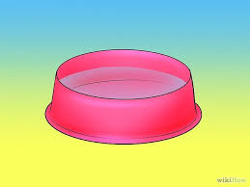
Mass is NEVER lost, it just changes form
(solid, liquid, gas)
Ex. Set a bowl of water outside on a hot day.
The mass of the water in the bowl will get smaller and smaller, but the missing mass is NOT lost.
It is equal to the mass of the water that has evaporated into the air.

Slide 14
Video Clip Options
https://youtu.be/ki4O-Fy3z-0 4 min
https://youtu.be/xYFAj50c7xM 4 min
https://youtu.be/68QDZAl29oE 9 min
https://youtu.be/zD7HCI4Hhe4 14 min

Slide 15
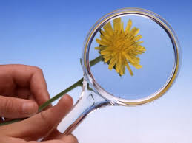
Observing Parts of Matter
Objects and materials are made up of smaller parts that can be too small to see with your eyes. You must magnify, or make them appear larger than they are.

Slide 16


Hand Lens
A hand lens is one tool that makes small objects appear larger. You can use this to see the parts of small object.
Ex. To see the tiny hairs that covers a bees back, or the veins of a leaf.

Slide 17
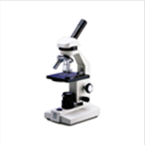
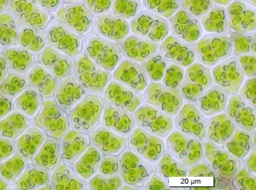
Microscope
A microscope is a tool that makes tiny objects appears much larger.
Ex. to see tiny parts such as the cells that make up a leaf.

Slide 18
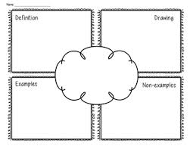
Create a frayer diagram that explains the word “Matter”

Slide 19
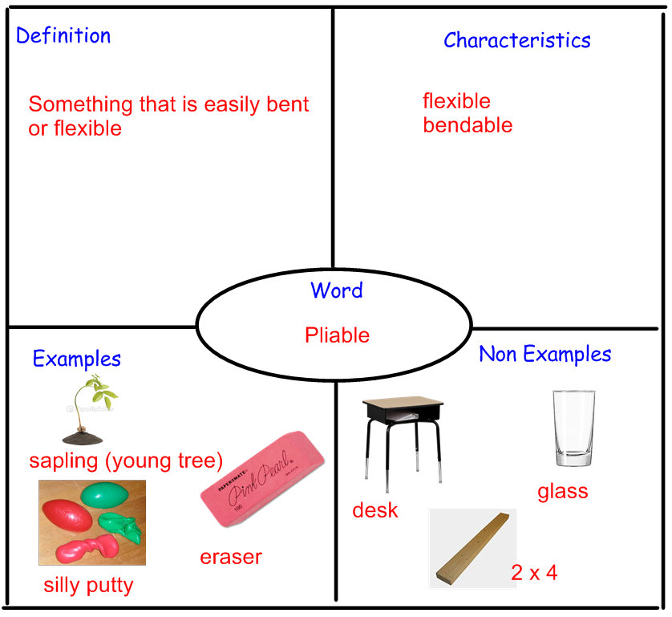
Sample Frayer

Slide 20

CLOSURE
ALL: Complete the “L” column of your K/W/L chart.
Most: Write a summary to an absent student that explains what matter is and why it’s important.
Some: Develop 2-3 multiple choice test questions related to our new term “Matter”.

Slide 21


Slide 22
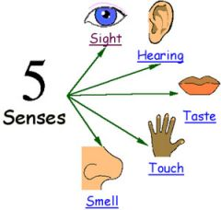
Physical Properties of Matter
A physical property is a feature that can be observed directly or measured with a tool. Used to describe, compare, and group kinds of matter.

Slide 23
Color
can be observed by looking at a substance
sulfur is yellow, graphite is gray salt is white
2. Taste
You can tell by tasting them.
Sugar & salt
3. Texture
The way a surface feels. You can touch to observe texture.
smooth, waxy, soft, powdery, greasy or grainy

Slide 24
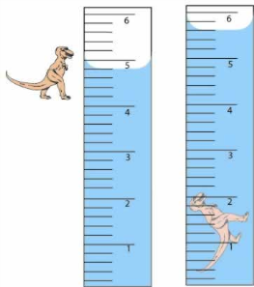
4. Volume
The amount of space that something takes up.
A tennis ball takes up more volume or more space than a marble
Volume is measured in two different ways:
Length x width x height and
Water displacement
An objects mass divided by its volume.
-A cube of sugar has a lower density than a cube of iron that is the same size.
5. Density
tells us how tightly packed particles are in an object
-If an object floats, it is LESS dense than the liquid
-wooden toothpick will float in a glass of water because the wood is less dense.
-if an object sinks, it is MORE dense than the liquid

Slide 25
Density
Interactive - Will it sink or float?
Measuring Mass Brain Pop Video

Slide 26
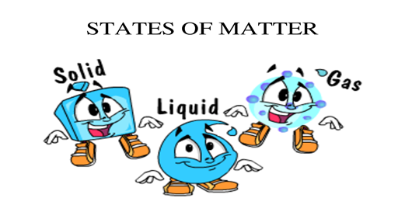
States of Matter: one of the forms that matter takes, such a solid, liquid or gas.

Slide 27
State of Matter | Definition | Example
1.Solid
2.Liquid
3.Gas
Has a fixed volume and a fixed shape.
Wooden block moved
The amount of space it takes up also stays the same.
Has a fixed volume but not a fixed shape.
Vinegar, water, and milk are liquids.
If you pour a liquid from one container to another, its shape changes.
Its volume stays the same.
Has no fixed volume or fixed shape
Helium in a balloon
Air
Steam

Slide 28
Solid Liquid and Gases an activity sorting items into three groups

Slide 29
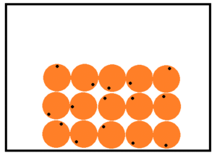
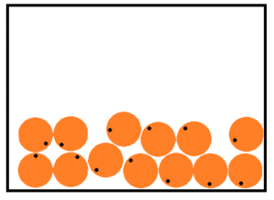
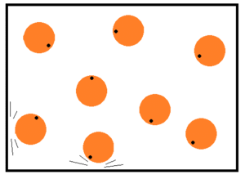
Solid
Tightly- packed
Liquid
closely- packed
Gas
loosely- packed
Solids: Particles only vibrate and cannot move from their position
Liquids: particles move enough to slide past each other
Gases: The particles bounce freely and rapidly
Changing Matter- Click here
Solid, Liquid, Gas animation
Study Jams Video - Solids, liquids, and gases
States of Matter BrainPop Video

Slide 30
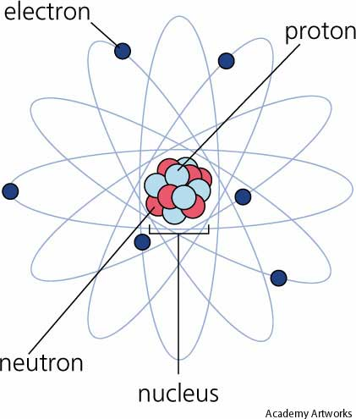
All matter is made up of very tiny particles called atoms.
Atoms join together to form larger particles called molecules.
These are too small to be seen with a compound light microscope.

Slide 31
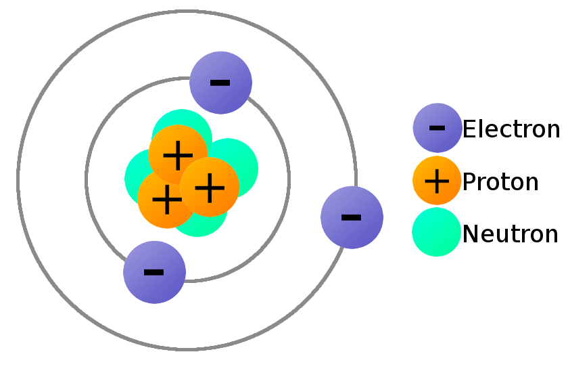
Atoms: All matter is made up of Elements. Elements are made up of TINY particles called ATOMS
Protons: have a positive charge and are located in the center of the nucleus
Neutrons: do NOT have a charge and are located in the center of the nucleus
Electrons: have a negative charge and are located on the outside of the nucleus
Nucleus: dense body in the center of the atom, “the brain”

Slide 32

The Atoms Family was created by Kathleen Crawford, 1994Presentation developed by Tracy Trimpe, 2006, http://sciencespot.net/

Slide 33
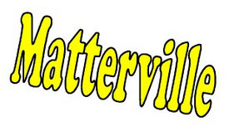
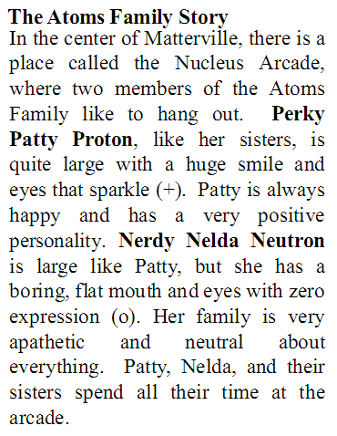
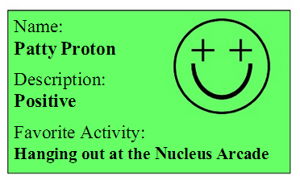
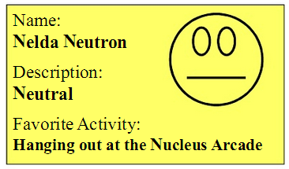

Slide 34
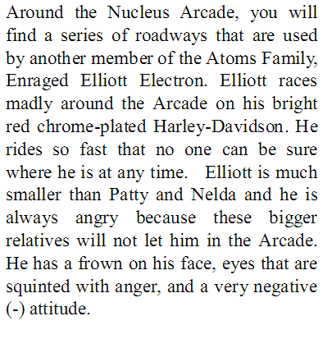
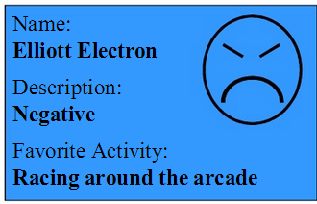
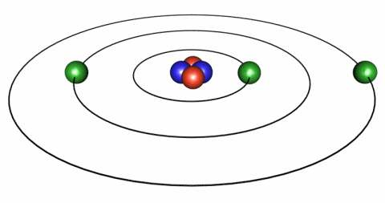
Atoms Brain Pop Video

Slide 35
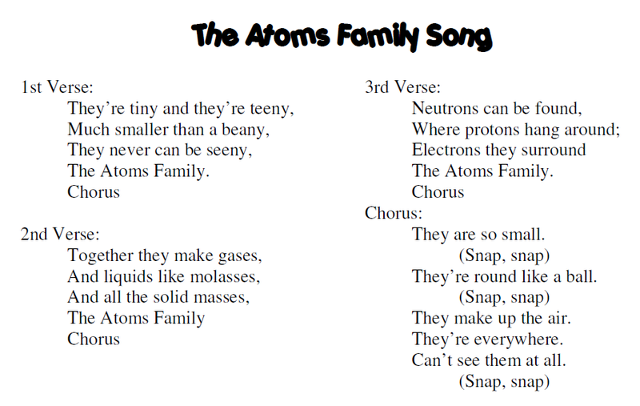

Slide 36
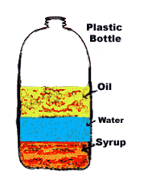
Activity
Have students make predictions about the density of three different liquids in your classroom such as vegetable oil, water and syrup. Students could then observe the arrangement of these liquids when they are combined in a density column. Ask students to explain the relative densities of these liquids based on their positions in the column.

Slide 37
Bill Nye The Science Guy - Phases of Matter
Bill Nye The Science Guy - Atoms and Molecules

Slide 38

Vocabulary – Words to Know
Matter: anything that takes up space.
Mass: the amount of matter in an object.
Weight: a measure of the pull of gravity on an object’s mass.
Magnify: to make something appear larger than it is.
Hand lens: a tool that makes small objects appear larger.

Slide 39
6. Microscope: a tool that makes tiny objects appear much larger.
7. Physical property: a characteristic of an object or substance that can be observed directly or measured with a tool.
8. Texture: the way a surface feels, such a rough or smooth.
9. Volume: the amount of space that something takes up.
10. Density: an object’s mass divided by its volume.

Slide 40
11. State of matter: one of the forms that matter takes, such as solid, liquid, or gas.
12. Solid: matter that has a fixed volume and a fixed shape.
13. Liquid: matter that has a fixed volume but not a fixed shape.
14. Gas: matter that has no fixed volume or fixed shape.

