Slide 1
Meiosis

Slide 2
2 kinds of reproduction
Asexual- results in offspring with genotypes that are exact copies of the parents
Sexual- results in offspring that share traits with their parents but are NOT exact copies
Important INFO
“a” before word can mean “without”
Offspring- the “children” what is made after the reproduction occurs

Slide 3
Asexual Reproduction
What is an example of Asexual reproduction?
(WHERE THE “DAUGHTER CELLS” ARE THE EXACT SAME AS THE PARENTS)
MITOSIS!
Where 1 cell makes 2 identical daughter cells

Slide 4
Sexual Reproduction
Sexual reproduction- 2 parent cells join together to form offspring that are different from both parents
Sex cells- the parent cells
Ordinary cells have 46 chromosomes
Sex cells have 23 chromosomes
(so, two sex cells need to combine to make a 46 chromosome cell)

Slide 5
Sexual Reproduction
Homologous chromosomes- chromosomes that have the same sequence of genes and the same structure
In sex cells, each cell only has 1 of the homologous chromosomes.
They come together to complete the match

Slide 6
Sexual Reproduction
Egg- female sex cell
Sperm- male sex cell
Zygote- first cell made from 2 sex cells. Has 46 chromosomes

Slide 7
Sexual Reproduction
ONE 23-chromosome sex cell + ONE 23-chromosome sex cell
=
1 46-chromosome cell
That one 46-chromosome cell (a zygote) will now continue to go through mitosis and make us grow!

Slide 8
Meiosis
Meiosis is similar to mitosis…only it goes through the similar process TWICE!
There are 8 steps in meiosis
Interphase + meiosis + cytokinesis = a 10 step cycle
What do you remember about Mitosis??

Slide 9
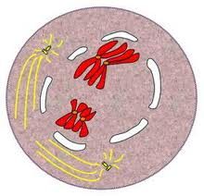
Meiosis
Prophase I
Chromatin turns to chromosomes
Nuclear membrane
breaks down
Centrioles move to poles
Spindle fibers start to form
→Crossing over occurs

Slide 10
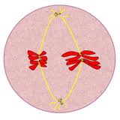
Meiosis
Metaphase I
Spindle fibers move
chromosomes to the
center of the cell

Slide 11
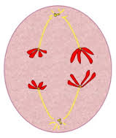
Meiosis
Anaphase I
Spindle fibers pull
the sister chromatids
apart

Slide 12
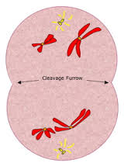
Meiosis
Telephase I
The homologous structures split apart
Nuclear membrane will
Start to form again
Cytokinesis will occur to
Split apart the 2 new cells

Slide 13
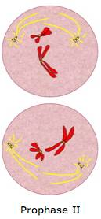
Meiosis
Prophase II
Each cell now contains one member of each homologous chromosome pair
Not much happens here
Centrioles are already here
Spindle fibers are already here
The DNA is in the chromosome form

Slide 14
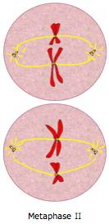
Meiosis
Metaphase II
The chromosomes line up in the center
(just like in metaphase I !)

Slide 15
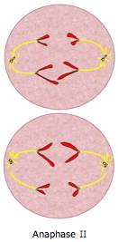
Meiosis
Anaphase II
The chromatid sisters are pulled apart (just like in anaphase I !)

Slide 16
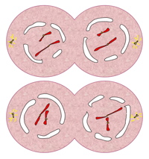
Meiosis
Telephase II
New nuclear membranes form around the chromosomes
The cells begin to divide (cytokinesis again)

Slide 17
Meiosis
The result:
4 new sex cells, each with just half of the number of chromosomes as in a “regular” cell
23
23
46
23
23
Notes:
Smiley face is a link to an animation (a little boring…but goes through the steps well)

Slide 18
Something to ponder…
Meiosis is reason we all look different….we have “genetic variation”
Why? How?

Slide 19
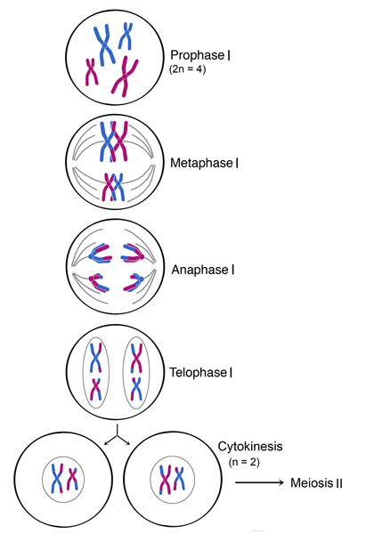
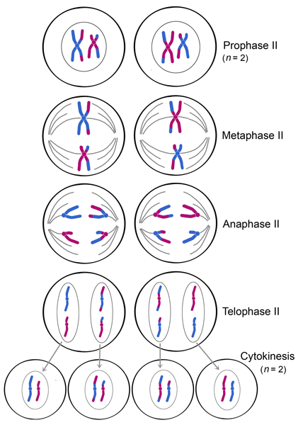
animation

Slide 20
Play-do PHASES Textbook pages 274-275
Pair up with one other person and find a spot in the room
Clear off the desk/table
Get ONE container of play-do (do not open it yet)
You will be making a phase of meiosis with the Play-do and then explaining your phase to Ms. Stanford & your classmates.
Start to make you play-do meiosis phase, remember to include (if applicable):
Chromatin/chromosomes
Spindle fibers and centrioles
membranes
Notes:
There are 8 parts of Meiosis, but if there are more than 8 groups, you can have a group do interphase and cytokinesis

Slide 21
Science Closure
A cell with a diploid number of 24 undergoes meiosis, how many chromosomes are in each daughter cell? A. 6 B. 12 C. 24 D. 48

