Slide 1
Homeroom Warm Up 1/11/2022
Mirror, Mirror: What if you mirror started talking to you? What might the mirror say?

Slide 2
Today’s schedule
Class Time | Class Period
8:38-9:28 | 2nd period exploratory (N. Miller)
9:31-10:21 | 3rd period exploratory (Paladino he is out today, please use for Iready)
10:24-11:14 | 4th period Math (Ware)
11:17-12:07 | 5th period ELA (Johnson)
12:10-12:35 | Lunch
12:38-1:28 | 6th period Science (Stanford)
1:31-2:21 | 7th period social studies (Greer is providing worksheets)
2:24-3:15 | 8th period intervention (Houston)

Slide 3
Science Warm Up 1/11/2022
A stomach is made up of multiple tissues. What level of organization is a stomach?
Cell B. Organ
C. Organ System D. Organism

Slide 4
Agenda
Introduce Phenomenon
Break Down Objective
Copy Word Wall
Mitosis Notes/Video
Closure

Slide 5
Take a look at the picture below and complete the following sentences with your own responses
1. This makes me think of….
2. I wonder….
3. I have some questions….
4. This makes me want to….

Slide 6
Made up of, or involving more than one and usually many cells
A process of cell division that forms two new nuclei that have the same number of chromosomes
o give the reason for or cause of
To determine
SWBAT evaluate information about the function of mitosis in multicellular organisms IOT explain the growth and repair of cells through the production of genetically identical daughter cells.
Relating to or determined by the origin
Are produced after a single cell undergoes cell division

Slide 7
Word Wall pages 261-269
1.Mitosis
2. DNA
3. Cell Cycle
4. Chromosomes
5. Interphase
6. Cytokinesis

Slide 8
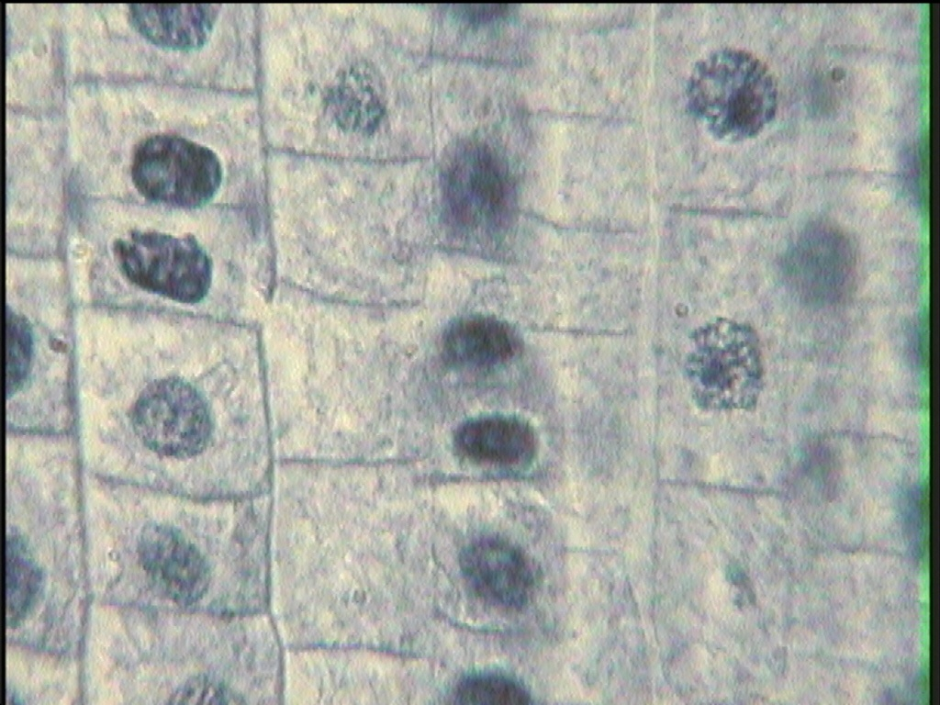
Asexual Reproduction
Mitosis
DSQ: Mitosis is the process in which the nucleus divides to form two new nuclei. How does mitosis differ in plants and animals?
Ms. Stanford
7th Grade Life Science
8

Slide 9
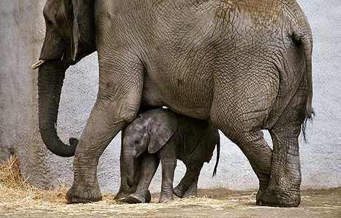
How do little elephants grow up to be BIG elephants?

Slide 10
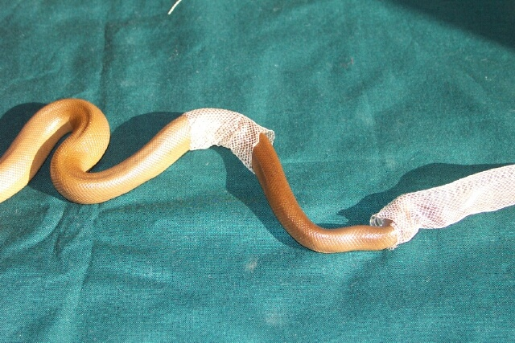
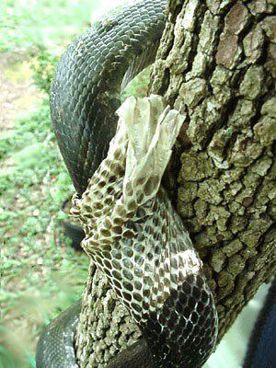
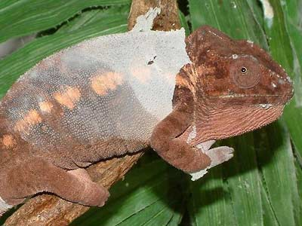
Why do animals shed their skin?

Slide 11
Mitosis is an type of asexual reproduction and begins after fertilization occurs.

Slide 12
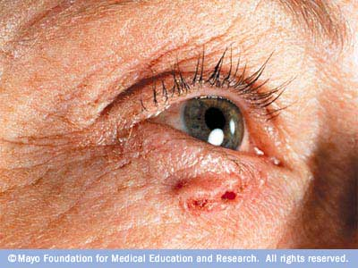
Three reasons why cells reproduce by asexual reproduction: 1. Growth 2. Repair 3. Replacement
Skin cancer - the abnormal growth of skin cells - most often develops on skin exposed to the sun.
Cell that reproduce by asexual reproduction reproduce constantly.

Slide 13
The Cell Cycle
http://www.cellsalive.com/mitosis.htm
Interphase
Prophase
Metaphase
Anaphase
Telophase & Cytokinesis

Slide 14
Interphase occurs before mitosis begins
Chromosomes are copied (# doubles) . The cell prepares for division. Chromosomes are copied.
Chromosomes appear as threadlike coils (chromatin) at the start, but each chromosome and its copy(sister chromosome) change to sister chromatids at end of this phase
CELL MEMBRANE
Nucleus
Cytoplasm

Slide 15
Interphase
Animal Cell
Plant Cell
Photographs from: http://www.bioweb.uncc.edu/biol1110/Stages.htm

Slide 16
Prophase 1st step in Mitosis
Mitosis begins. Chromosomes condense into rodlike structures. (cell begins to divide)
Centrioles (or poles) appear and begin to move to opposite end of the cell.
Spindle fibers form between the poles.
Centrioles
Sister chromatids
Spindle fibers

Slide 17
Prophase
Animal Cell
Plant Cell
Spindle fibers
Centrioles
Photographs from: http://www.bioweb.uncc.edu/biol1110/Stages.htm

Slide 18
Metaphase 2nd step in Mitosis
Chromatids (or pairs of chromosomes) attach to the spindle fibers. Chromosomes line up at the center of the cell.
Centrioles
Spindle fibers

Slide 19
Metaphase
Animal Cell
Plant Cell
Photographs from: http://www.bioweb.uncc.edu/biol1110/Stages.htm

Slide 20
Anaphase 3rd step in Mitosis
The chromosomes divide and begin to move to opposite sides of the cell.
Centrioles
Spindle fibers

Slide 21
Anaphase
Animal Cell
Plant Cell
Photographs from: http://www.bioweb.uncc.edu/biol1110/Stages.htm

Slide 22
Telophase 4th step in Mitosis
Two new nuclei form.
Chromosomes appear as chromatin (threads rather than rods).
Mitosis ends.
Nuclei
Nuclei
Chromatin

Slide 23
Telophase
Animal Cell
Plant Cell
Photographs from: http://www.bioweb.uncc.edu/biol1110/Stages.htm

Slide 24
Cytokinesis occurs after mitosis
Cell membrane moves inward to create two daughter cells – each with its own nucleus with identical chromosomes.

Slide 25
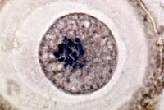
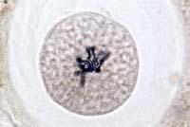
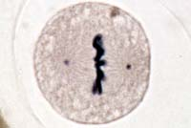
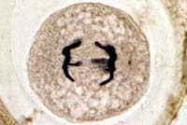
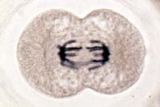
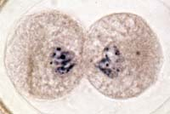
Animal Mitosis -- Review
Interphase | Prophase
Metaphase | Anaphase
Telophase | Interphase

Slide 26
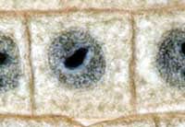
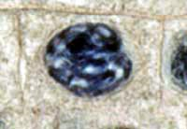
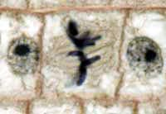
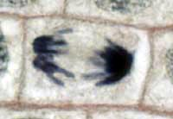
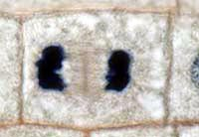
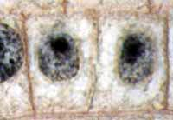
Plant Mitosis -- Review
Interphase | Prophase
Metaphase | Anaphase
Telophase | Interphase

Slide 27
REMEMBER!
Interphase
Prophase
Metaphase
Anaphase
Telophase
Cytokinesis
IPMATC
I Pray More At The Church
Notes:
A mnemonic to help remember the stages of mitosis.

Slide 28
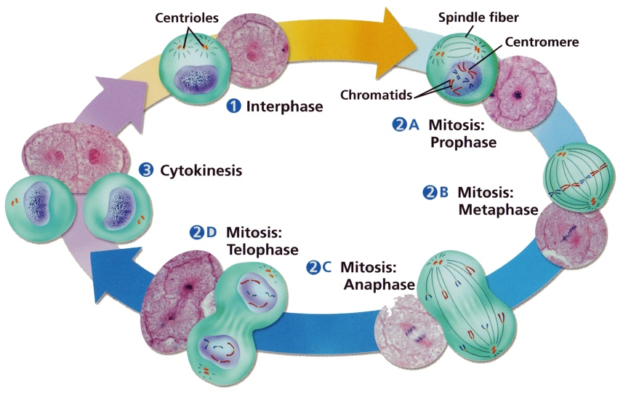
Cell Cycle

Slide 29
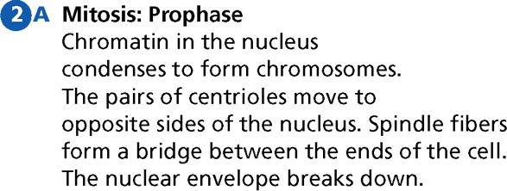
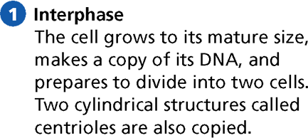
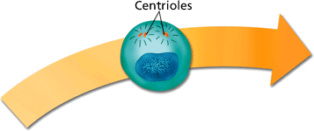
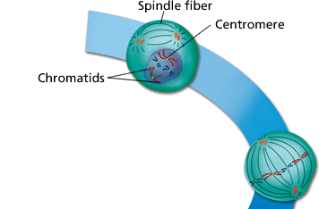
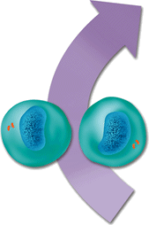
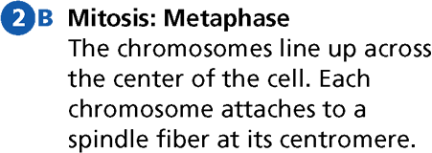
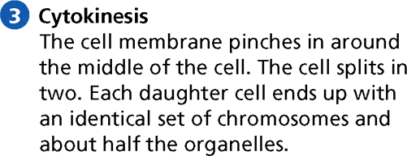
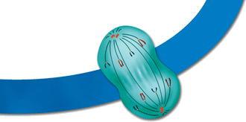
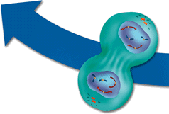
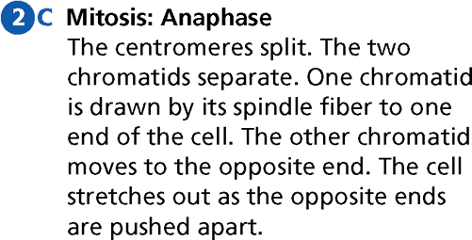
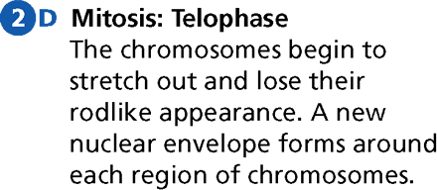
The Cell Cycle
- Cell Division
29

Slide 30
Mitosis Video
https://www.youtube.com/watch?v=f-ldPgEfAHI

Slide 31
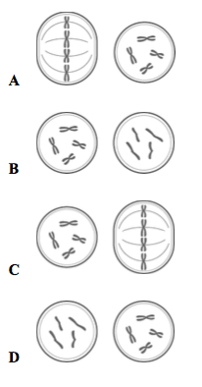
Science Closure 1/11/22
Look at this mitosis diagram. Which two phases complete the mitosis diagram in the correct order?

