Slide 1
characteristics that can be observed during or after a chemical reaction
characteristics of a substance that describes it
explain the meaning
examine in detail
SWBAT analyze and interpret data from the periodic table’s organization to predict the physical and chemical properties of an element in order to identify an unknown sample of matter.
a property that is measurable without changing the identify of the matter.
anything that has mass and takes up space

Slide 2
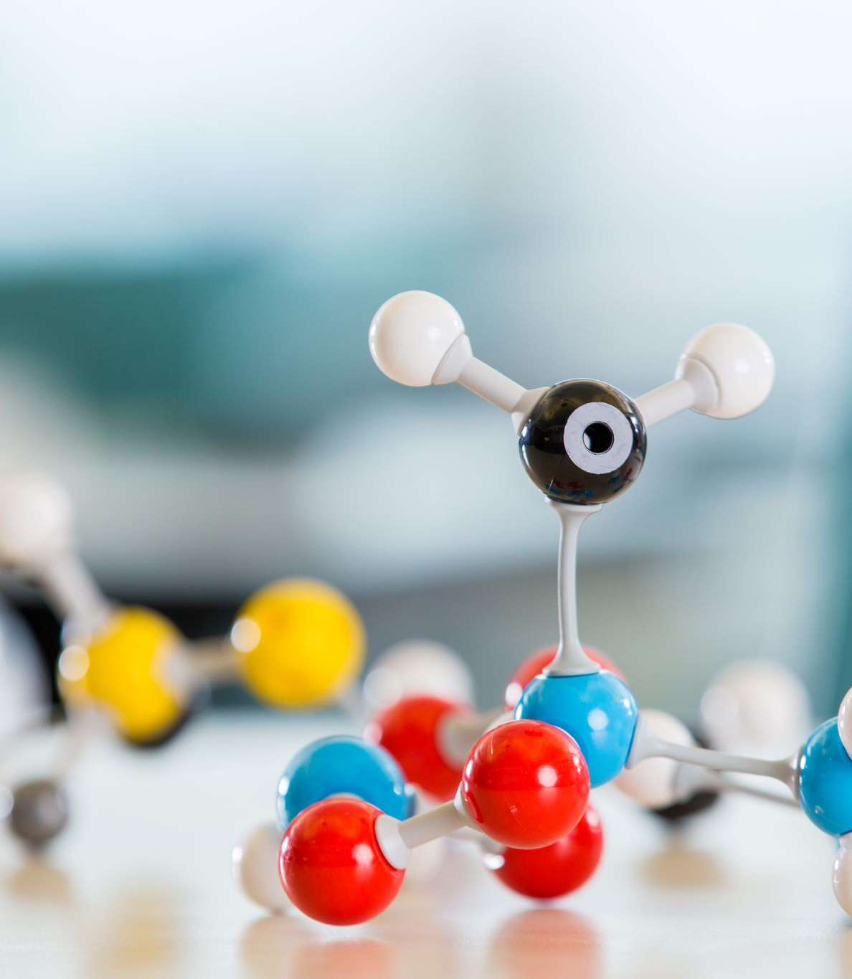
Agenda
Warm Up
Objective Overview
Periodic Table Video*
Complete notes on the Periodic table
Atom Structure test retake details
Closure

Slide 3
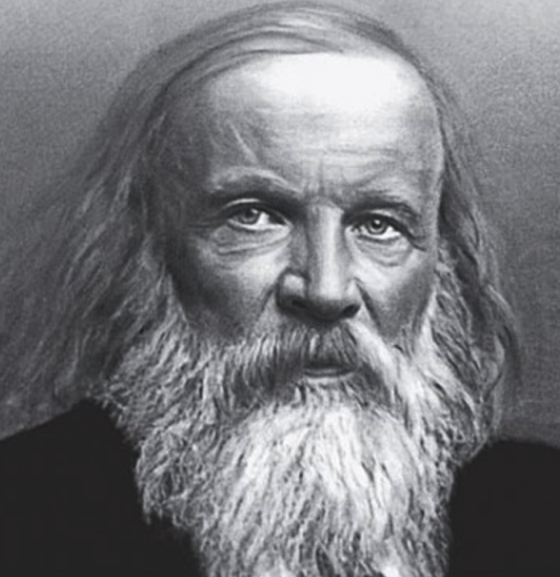
Mendeléev
The first accepted version of the periodic table was created in 1869 by Dmitri Ivanovitch Mendeléev
He grouped elements according to their atomic mass, and as he did, he found that the families had similar chemical properties
His understanding was so advanced that he left blank spaces for elements he knew would be there but weren’t yet discovered

Slide 4
The Current Periodic Table
Mendeleev was very close
He organized the elements by atomic mass. Today, we place them in rows by increasing atomic number
The horizontal rows are called periods and are labeled from 1 to 7
The vertical columns are called groups are labeled from 1 to 18

Slide 5
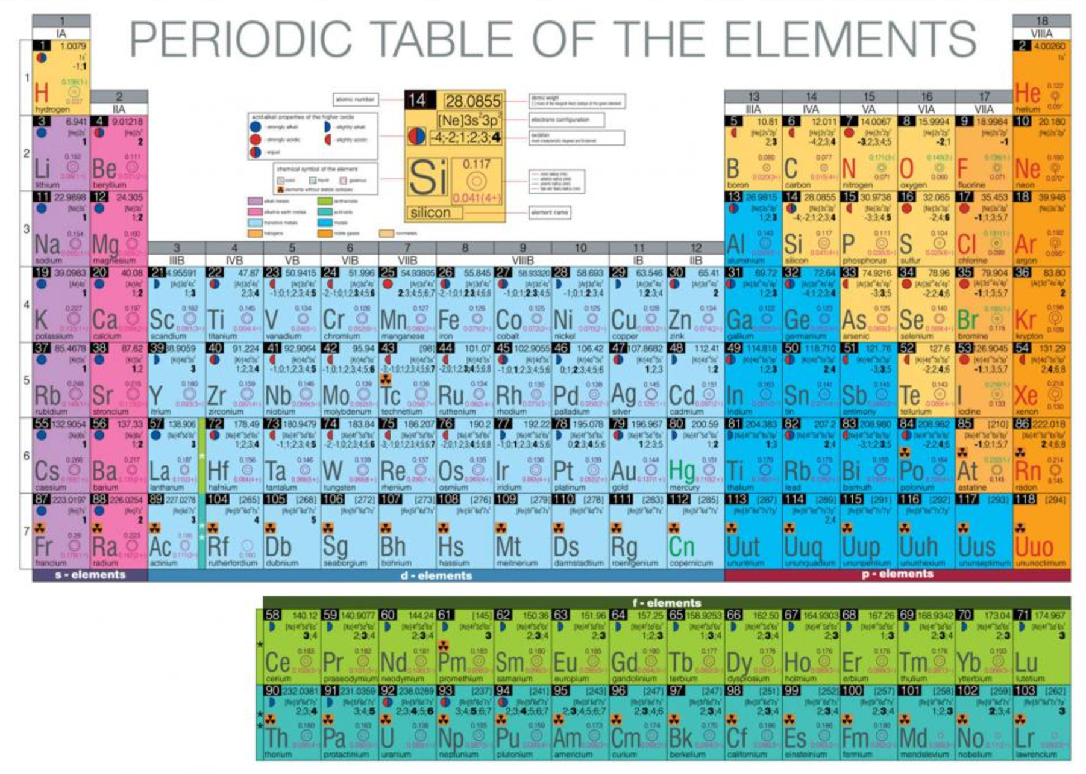

Slide 6
The Elements
There are 118 elements, 92 of which occur naturally
The remainder have been created in the lab
The universe as we know it is created out of these elements and nothing else however, there may be others we aren’t yet aware of

Slide 7
The Periodic Table
The periodic table organizes the elements in a particular way. A great deal of information about an element can be gathered from its position in the period table.
For example, you can predict with reasonably good accuracy the physical and chemical properties of the element
You can also predict what other elements a particular element will react with chemically.

Slide 8
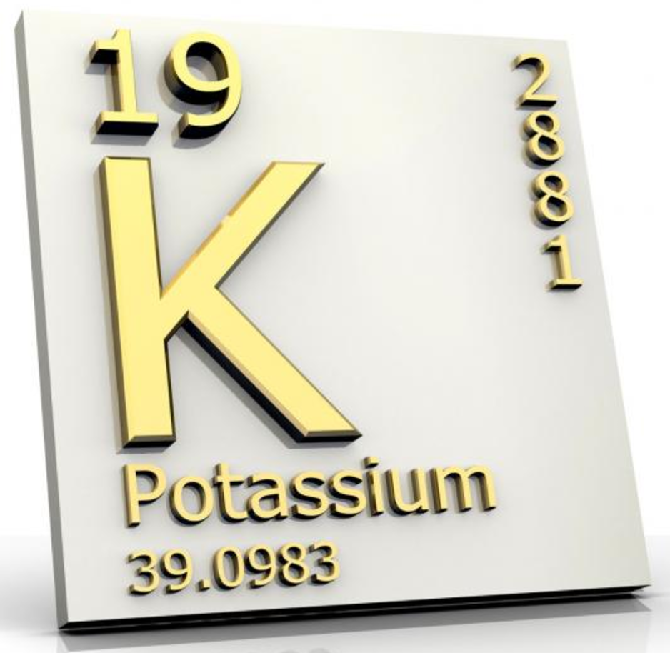
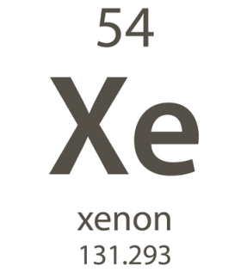
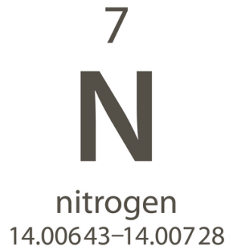
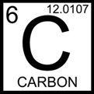
Atomic Numbers
Elements are organized on the table according to their atomic number, usually found near the top of the square.

Slide 9
What does each square tell us?
Different periodic tables can include various bits of information, but usually include the
atomic number
symbol
atomic mass
state of matter at room temperature

Slide 10
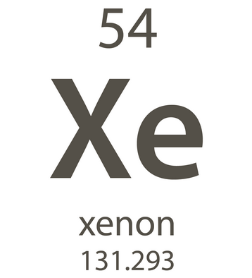
Atomic Number
Refers to how many protons an atom of that element has
No two elements have the same number of protons

Slide 11
Atomic Mass
Atomic Mass refers to the “weight” of the atom
It is found by adding the number of protons and the number of neutrons

Slide 12
An atom’s mass is measured in Atomic Mass Units (AMU)
1 AMU is very small
There are 6 X 10²³ or 600,000,000,000,000,000,000,000 AMUs in one gram
(Recall: Protons and Neutrons = 1 AMU, Electrons = 1/2000 AMU)
Since electrons contribute so little to the overall mass of an atom, they are simply ignored

Slide 13
Valence Electrons
The number of valence electrons an atom has may also appear in a square
Valence electrons are the electrons in the outer energy level of an atom
These are the electrons that are transferred or shared when atoms bond together

