Slide 1

Homeroom Warm Up
8/31/21
What would you do if someone gave you $1 million? Explain why
¿Qué harías si alguien te diera $ 1 millón? Explicar por qué

Slide 2
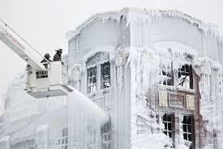
Science Warm Up
Write 3-5 complete sentences to explain what caused last week’s phenomenon
Escribe de 3 a 5 oraciones completas
para explicar qué causó el fenómeno de la semana pasada.

Slide 3
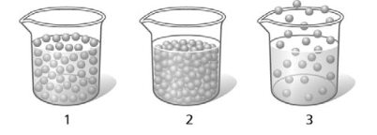
Science Warm Up
8/31/21
The diagram illustrates particles in three states of matter. What do each of the states of matter have in common?
A. The particles are in fixed positions.
B. The particles in each are in constant motion.
C. The particles take the shape of their containers.
D. The particles have the same volume in each container.
El diagrama ilustra partículas en tres estados de la materia. ¿Qué tienen en común cada uno de los estados de la materia?
A. Las partículas están en posiciones fijas.
B. Las partículas de cada uno están en constante movimiento.
C. Las partículas toman la forma de sus contenedores.
D. Las partículas tienen el mismo volumen en cada recipiente.

Slide 4

Homework:Nearpod Physical & Chemical Changes lesson due this Friday by 3PM.
2nd →XCTIF
3rd →6U4JM
4th→ PLI5C
6th → YGLW4
8th → IWQ79

Slide 5
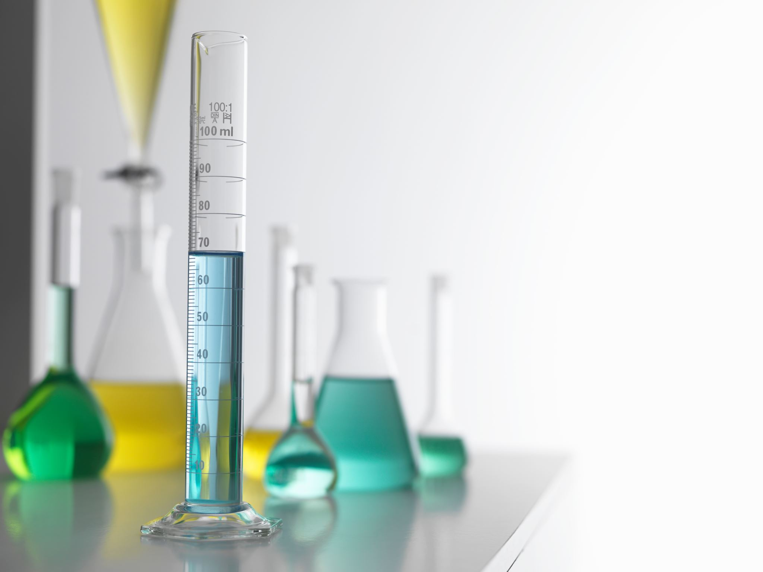
States of Matter/Phase Change Test
Makeup and Retake will be on this Wed.
*Remember if you scored less than 70 you will be allowed 1 re-take attempt to score up to 70.

Slide 6
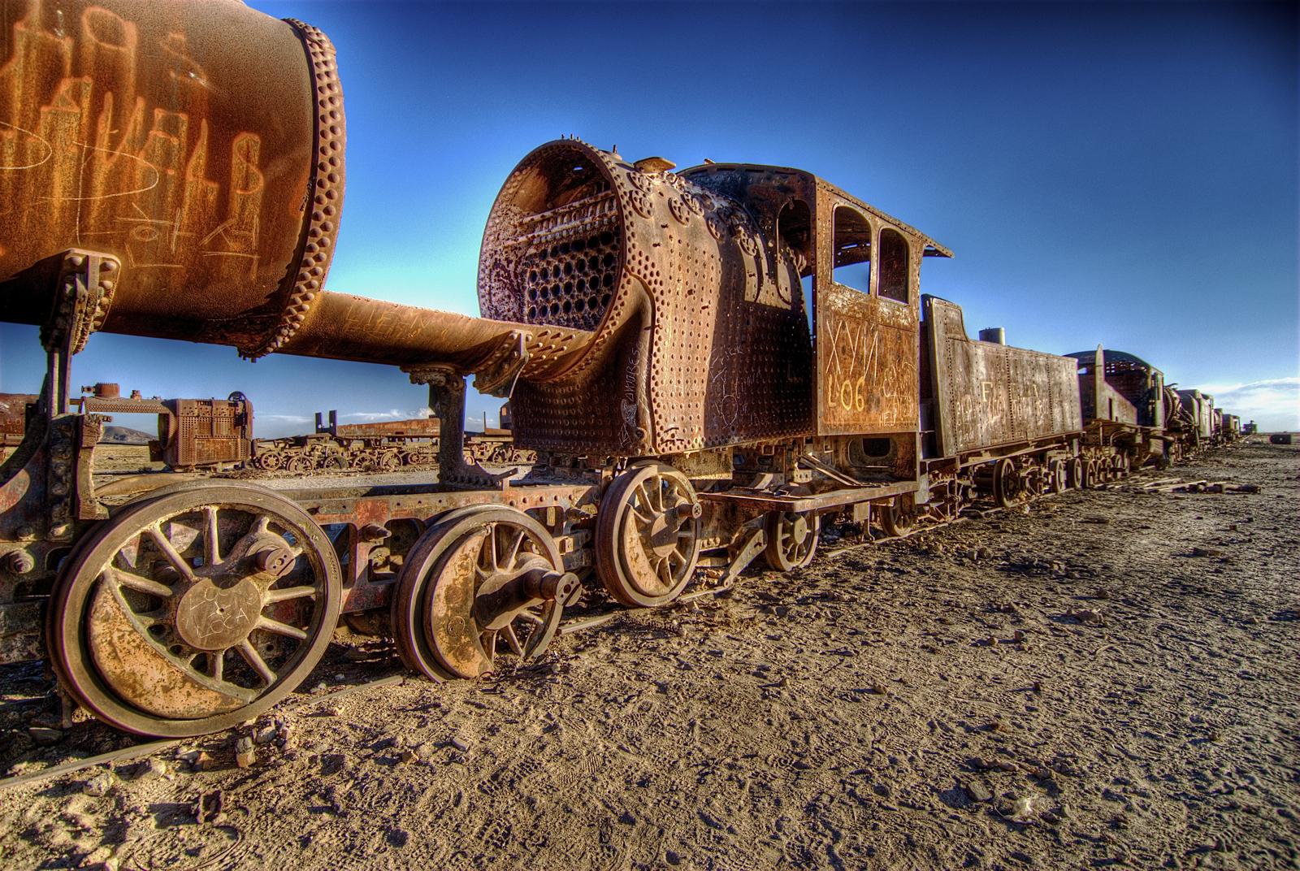
Take a look at the picture below and complete the following sentences with your own responses in your science notebook.
This makes me think of….
I wonder….
I have some questions….
This makes me want to….

Slide 7

Physical and Chemical Properties/
Changes

Slide 8
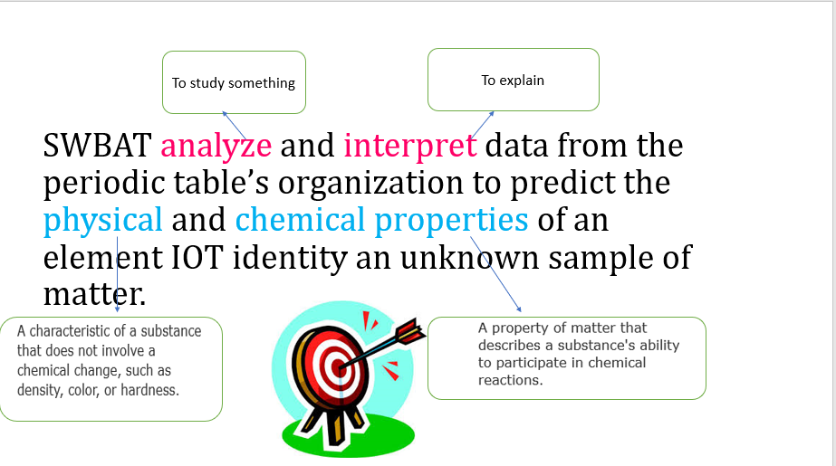

Slide 9
Weekly Vocab
Physical Change
Physical Property
Chemical Change
Chemical Property
Law of Conservation of Mass

Slide 10
Physical Properties
Physical property is a property that can be easily observed without changing the identity of the substance.
Examples:
viscosity
conductivity
malleability
hardness
magnetism
melting point
boiling point
density
color

Slide 11
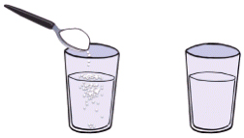
Examples of Physical Properties
A. Solubility of a substance is
its ability to dissolve.
Example: sugar in water
B. Conductivity is a material’s ability to allow heat or electricity to flow.
Examples: metal = high conductivity
wood = poor conductivity

Slide 12
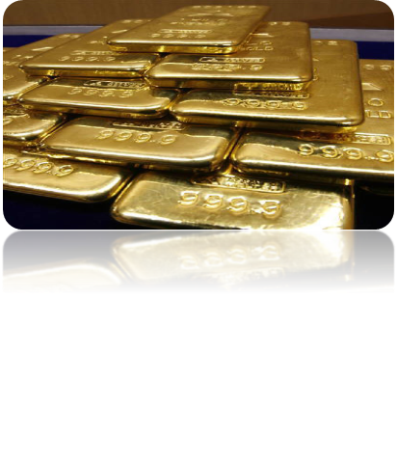
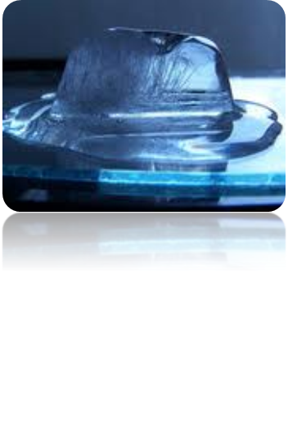
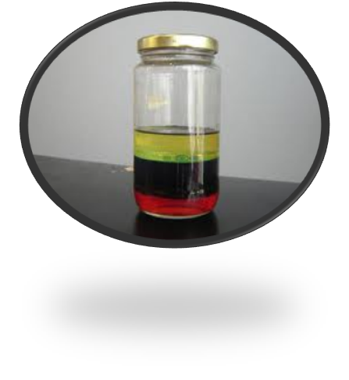
Examples of Physical Properties
C. Malleability of a substance is
its ability to be hammered into a thin sheet
D. Melting and Freezing points are the temperatures at which a solid becomes a liquid and a liquid becomes a solid.
E. Density of a substance is a measure of how close together its particles are.
Low density = float
High density = sink

Slide 13
Physical Change
A change in the appearance, without changing the identity of the material.
Can be reversible, or irreversible
Substance may seem different, but the way the atoms link up is the same.
It is a physical change if . . .
It changes shape or size
It dissolves.
Or the substance changes phase.

Slide 14
Chemical Properties
Chemical property is any ability to produce a change in the identity of matter.
Examples of chemical properties . . .
flammability
reactivity
Corrosive:
Eating away,
such as a
metal by acid
Material’s ability to burn in the presence of oxygen.
How readily a substance combines chemically with other substances.

Slide 15

Chemical Changes
Chemical changes occur when a substance reacts and forms one or more new substances.
You know a chemical change has occurred when there is. . .
A change in color or odor.
Production of a gas (bubbling).
Formation of a precipitate (solid).
Absorb or release energy (gets hot or cold or light is given off).

Slide 16
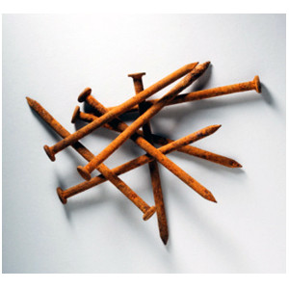

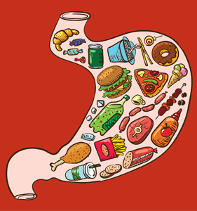
Examples of Chemical Changes:
Burning
Or Combustion:
Color change, odor change,
Produces a gas, gets hot
Rusting:
Color change
Corroding:
Color change
Digesting:
Color change, odor
Change, produces a
Gas, releases energy
Molding:
Color change
Decaying:
Color change

Slide 17

What kind of change is it?
A

Slide 18

What kind of change is it?
B

Slide 19
What kind of change is it?
C

Slide 20
What kind of change is it?
D

Slide 21

What kind of change is it?
E

Slide 22

What kind of change is it?
F

Slide 23
Physical
Chemical
A
C
D
F
B
E

Slide 24
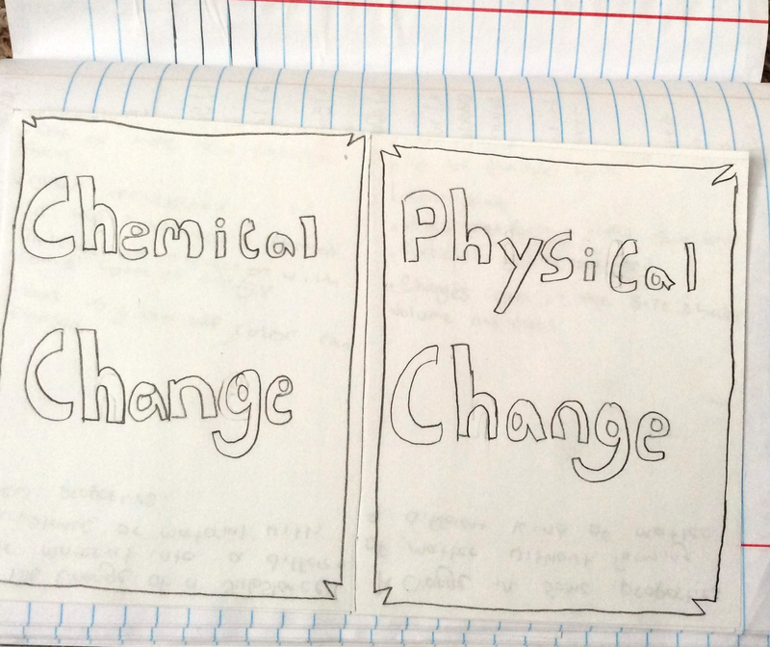
Create a foldable to compare
Chemical & Physical Changes

Slide 25
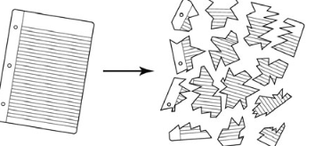
Science Closure
Marco tears a piece of notebook paper into
smaller pieces, as shown below. Tearing paper into pieces is an example of what kind of change?
A. a change in mass
B. a physical change
C. a chemical change
D. a change in energy

