Slide 1
Science Do Now 8/27/18
Hydrogen gas (H₂) can be found in trace amounts in Earth’s atmosphere. Which of these statements describes a physical property of hydrogen?
A. Hydrogen is found in acids.
B. Hydrogen gas is highly flammable.
C. Hydrogen reacts with oxygen to form water.
D. Hydrogen gas is less dense than oxygen gas.

Slide 2
Take a look at the picture below and complete the following sentences with your own responses in your science notebook.
1. This makes me think of….
2. I wonder….
3. I have some questions….
4. This makes me want to….
Sea Water
Questions

Slide 3
Pure Substances and Mixtures
7.PS1.2 Compare and contrast elemental molecules and compound molecules.
7.PS1.3 Classify matter as pure substances or mixtures based on composition.

Slide 4
Key Vocabulary
Atom
Element
Compound
Mixture
Pure Substance
Heterogeneous
Homogeneous

Slide 5
Pure Substance/Mixture Graphic Organizer
You will use the information is this PowerPoint to complete your graphic organizer.
You will only write down the information in red.
Wait to be told WHERE to write the information in your organizer.

Slide 6
PURE SUBSTANCES
Compositions are definite (they never change). They can either be an element, molecule or compound.

Slide 7
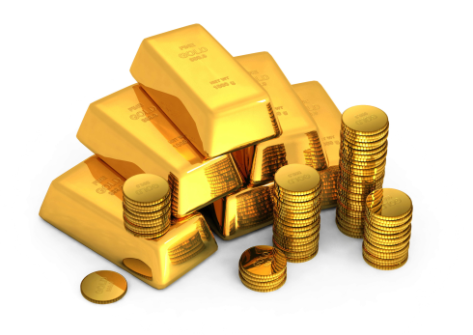
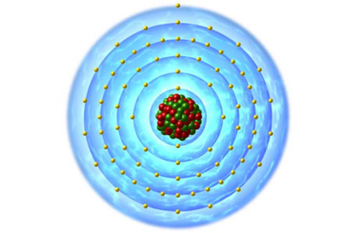
Atoms
Pure Substance
The smallest unit of matter.
Made up of protons, neutrons and electrons.
Keeps it’s physical and chemical properties.
For example, one ATOM of gold would still have the properties of gold. (malleable, lustrous, etc.…)

Slide 8
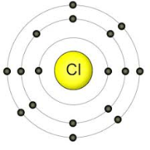
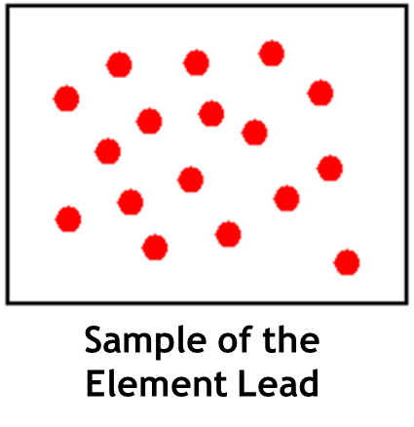
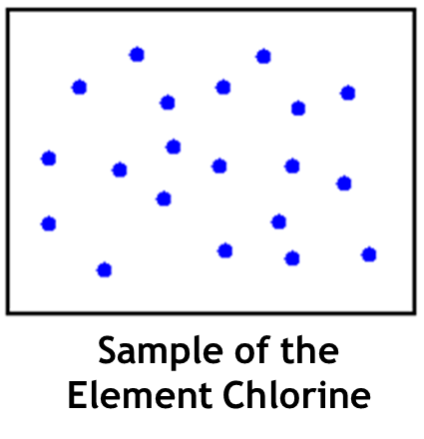
Elements
Pure Substance
Elements are made of one type of atom.
Cannot be broken down into simpler substances.
Found on the periodic table.
Example: Chlorine, Lead, Gold

Slide 9
Elements Combine in Chemical Reactions to Form Molecules
Oxygen and Hydrogen bond together to form water.

Slide 10
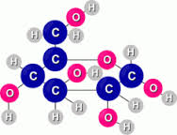
Molecules and Compound
Pure Substances
When elements chemically bond together, it creates molecules.
Molecules can be the same element bonded together or many different types of elements bonded together.
2 hydrogen atoms bonded together
Carbon, oxygen and Hydrogen bond to create a molecule of sugar.

Slide 11
Molecules and Compounds
Some molecules are called compounds.
Compounds are molecules that are made up of more than 1 type of atom.
For example (from previous slide)
NOT a Compound
Compound

Slide 12
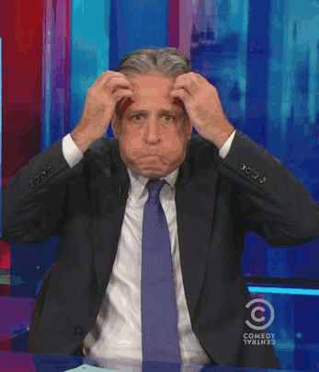
ALL compounds are molecules, but not all molecules are compounds.

Slide 13
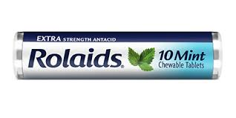
Some compounds have those scientific names like…..
Carbon Dioxide
Iron Oxide (rust)
Sodium Chloride (salt)
Sodium Bicarbonate (baking powder)
Dihydroxyaluminum sodium carbonate (Rolaids)

Slide 14
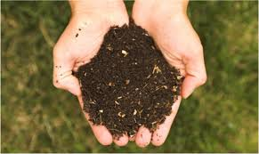
Mixtures
Not Pure Substances
Made up of 2 or more substances that are NOT chemically bonded.
Each substance keeps it’s own identity.
For example:
Air
Ocean Water
Soil
Trail mix

Slide 15
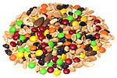
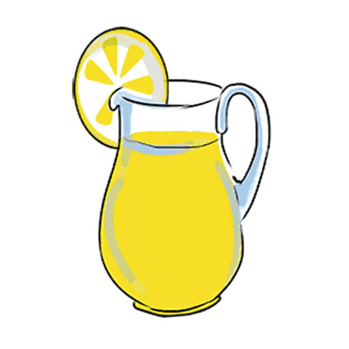
2 types of Mixtures
Heterogeneous Mixture – can see the different substances
Trail mix, Italian dressing, soil
“Shake well before use”
Homogeneous Mixture – appear to be same throughout (can not see different substances)
Air, milk, lemonade

Slide 16
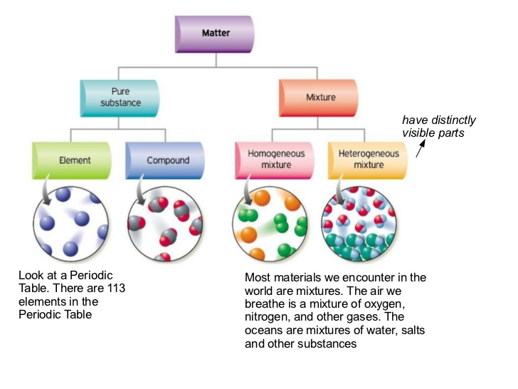

Slide 18
Science Closure 8/27/18
While elemental molecules and compound molecules are related, they are different. Unlike elemental molecules, compounds–
A. consists of only one type of atom.
B. are the smallest form of a particle.
C. exist only as pure substances.
D. are made of at least two different elements.

