Slide 1
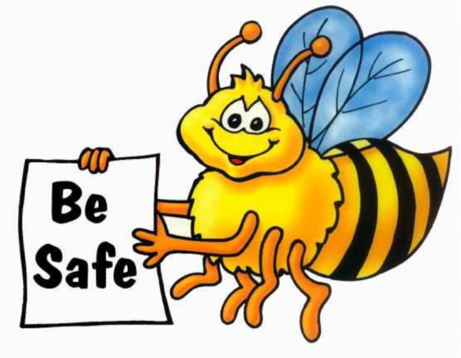
Weekly Enrichment Activities
Read notes on Air Pollution included in this ppt
Watch videos on Humans & the Environment and Air Pollution on BrainPOP. Also answer the quiz questions for each video.
Define vocabulary terms listed on Science textbook page 467.
Read and complete Science textbook pages 467-477.
Have a great week!

Slide 2
The Environment and Air Pollution

Slide 3
What is air pollution?
Air pollution is when unwanted chemicals, gasses, and particles enter the air and the atmosphere, causing harm to animals and damaging the natural cycles of the Earth.

Slide 4
Natural Causes of Air Pollution
Some sources of air pollution come from nature.
These include eruptions of volcanoes, dust storms, and forest fires.

Slide 5
Human Causes of Air Pollution
Human activity is a major cause of air pollution, especially in large cities. Human air pollution is caused by things such as factories, power plants, cars, airplanes, chemicals, fumes from spray cans, and methane gas from landfills.

Slide 6
Burning Fossil Fuels
One of the ways that humans cause the most air pollution is by burning fossil fuels. Fossil fuels include coal, oil, and natural gas. When we burn fossil fuels this releases all sorts of gasses into the air causing air pollution such as smog.

Slide 7
The hypothesis (or prediction)
What do you think will happen if we continue to pollute our environment?

Slide 8
Effects on the Environment
Air pollution and the release of gasses into the atmosphere can have many negative effects on the environment.
Global warming - One type of air pollution is the addition of carbon dioxide gas into the air. Some scientists believe that releasing too much carbon dioxide into the atmosphere is one of the causes of global warming. This upsets the balance of the carbon cycle.

Slide 9
Effects on the Environment
Air pollution and the release of gasses into the atmosphere can have many negative effects on the environment.
The ozone layer - The ozone layer helps protect us from harmful rays from the sun. It is getting damaged from air pollution such as methane gas from livestock and CFCs from spray cans.

Slide 10
Effects on the Environment
Air pollution and the release of gasses into the atmosphere can have many negative effects on the environment.
Acid Rain - Acid rain is created when gasses such as sulfur dioxide get high into the atmosphere. The wind can blow these gasses for miles and then they get washed out of the air when it rains. This rain is called acid rain and can damage forests and kill fish.

Slide 11
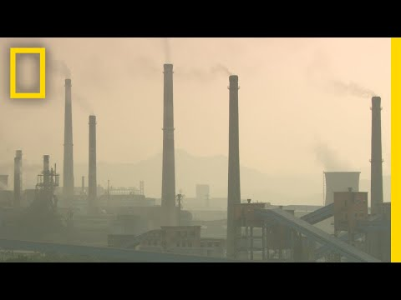
Air Pollution 101

Slide 12
Effects on Health
Air pollution can also make people sick. It can make it difficult to breathe and cause diseases such as lung cancer, respiratory infections, and heart disease.
According to the World Health Organization, 2.4 million people die each year from air pollution. Air pollution can be especially dangerous to children living in big cities with bad smog.

Slide 13
Air Quality Index
The Air Quality Index is a way for the government to alert people to the quality of the air and how bad the air pollution is in an area or city. They use colors to help you determine if you should go outside.
Green - the air is good.
Yellow - the air is moderate
Orange - the air is unhealthy for sensitive people like the elderly, children, and those with lung diseases.
Red - Unhealthy
Purple - Very unhealthy
Maroon - Hazardous

Slide 14
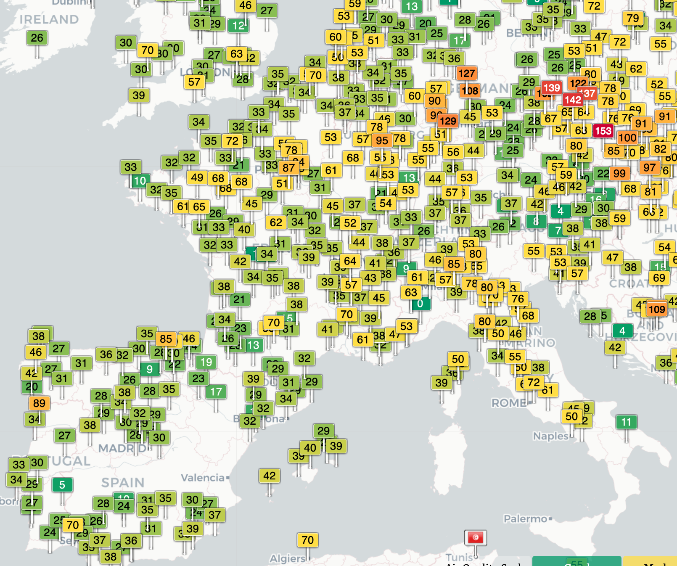

Slide 15
Real Time Air Quality Data
https://waqi.info/#/c/45.023/12.216/5.3z

Slide 16
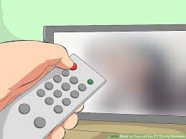
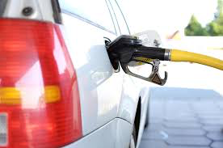
What can you do to help?

Slide 17
What can you do to help?
Anytime you can use less energy, like electricity or gasoline, it can help reduce air pollution. You can help by turning off the lights when leaving your room and not leaving the TV or computer on when you're not using it. Driving less helps a lot too. Be sure to talk to your parents about carpooling with friends and planning errands so that you can get them all done in a single trip. This saves money on gas as well, which everyone likes!

Slide 18
This is the most important takeaway that everyone has to remember.
YOU MAKE A DIFFERENCE!

Slide 19
Homework
Take the 10 question quiz about today’s lesson.
https://www.ducksters.com/science/quiz/air_pollution_questions.php

