Slide 1

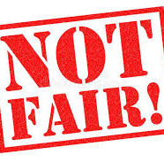
Homeroom Do Now
09/08/2020
If you are like most people, you probably have had experiences in which you have been treated in a way you consider unfair. Write about a time when you feel you were treated unfairly, and if you’ve never experienced write about a time you feel someone else was treated unfair.
*write at least 1 paragraph and be prepared to share

Slide 2
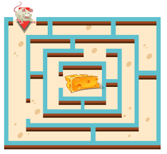
Science Warm Up
09/0/2020
A student hypothesized that a mouse would learn to run through a maze faster if food was at the end of the maze. Which tool will best help the student determine if the speed of the mouse improved?
A ruler
B thermometer
C stopwatch
D microscope

Slide 3

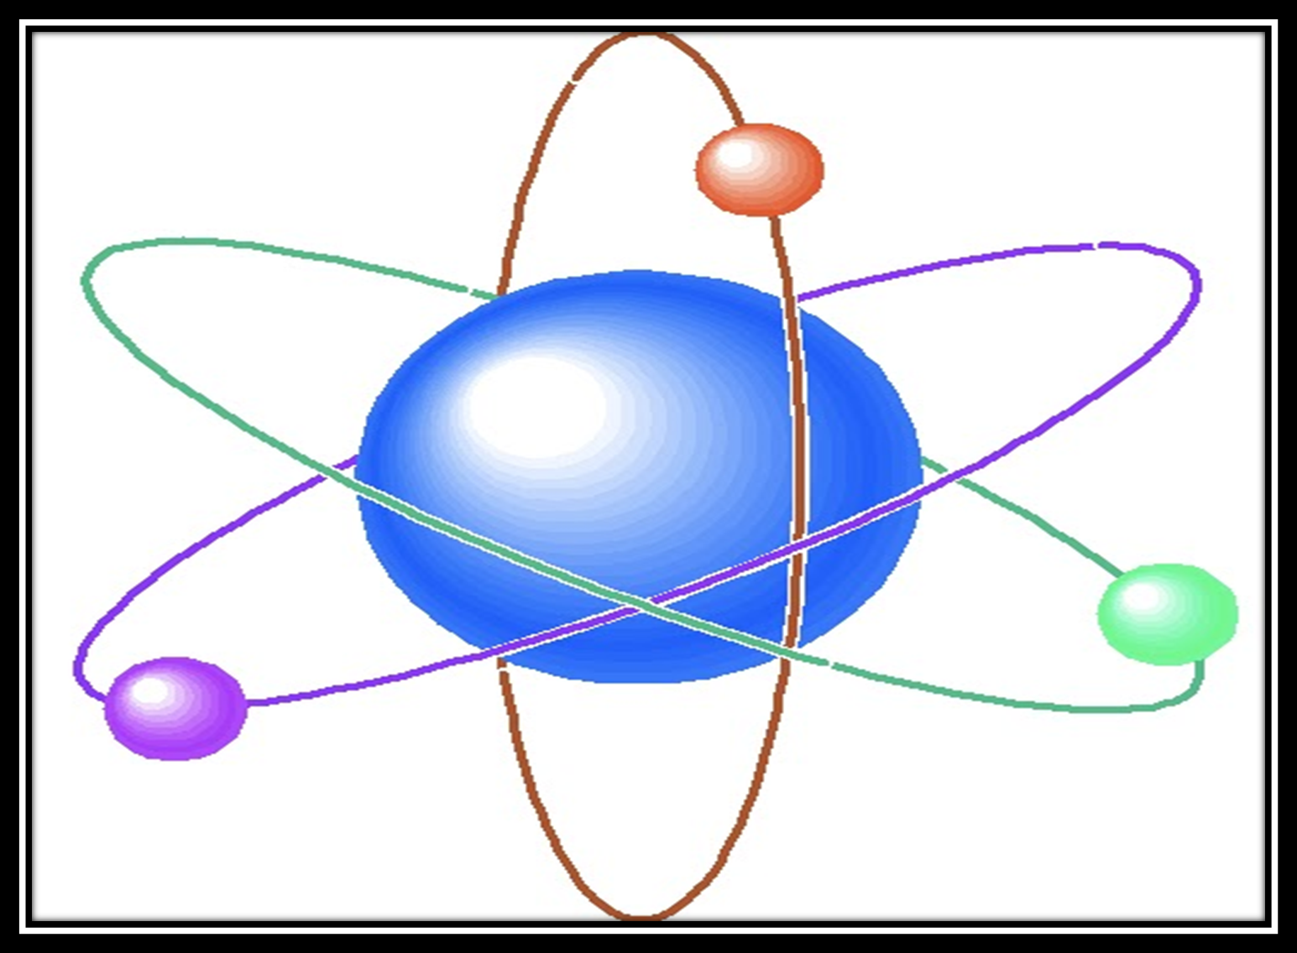

By: Cammie’s Corner

Slide 4

Weekly Homework
Read and complete pages 5-17 in your Science textbook

Slide 5
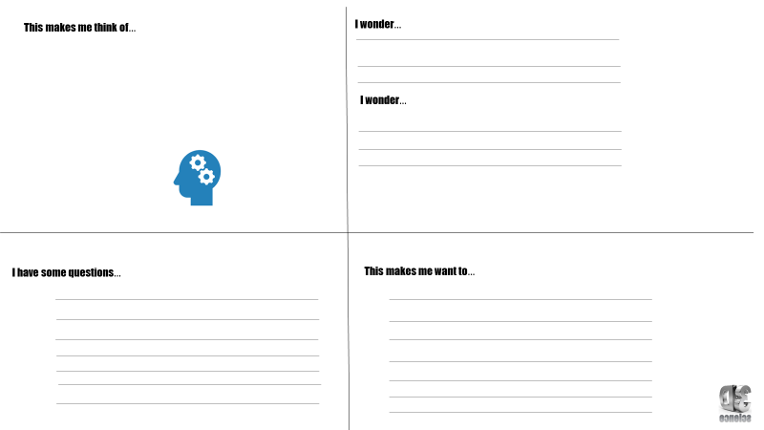
Use ½ page in your notebook to draw this chart and all words.
Copy the following chart along with all the writing into your notebook the best that you can. It should take up 1 full page.

Slide 6
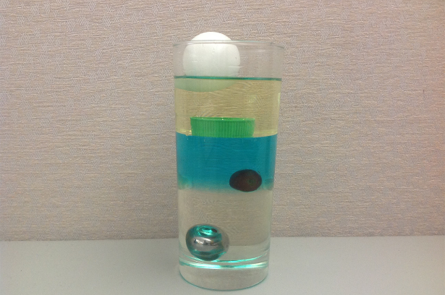

Slide 7


Matter
Matter: anything that has mass and volume (takes up space).
Examples: Everything around you is matter, you are matter, the air is matter

Slide 8
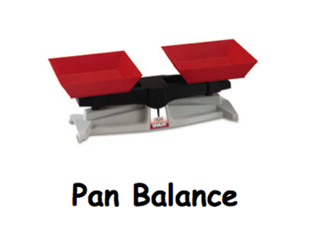
Mass
Mass: the amount of matter or stuff in an object.
Measured in grams and kilograms
Ex. Paper clip has a mass of about 1 gram, a liter of milk has a mass of about 1 kilogram.
You can measure mass with a balance.
The mass of an object is the same everywhere in the universe.
http://pbskids.org/cyberchase/math-games/poddle-weigh-in/

Slide 9
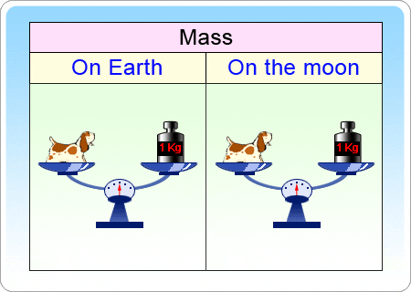

Slide 10

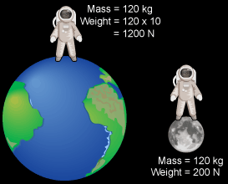
Weight
Weight: a measure of the pull of gravity on an object’s mass.
Because of gravity, weight is NOT the same everywhere in the universe. (on the moon you would weigh less than Earth).

Slide 11
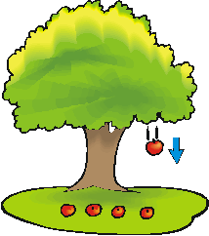
Gravity is a force of attraction between two objects. All objects with mass have gravity. Gravity acts like a magnet - pulling objects together.

Slide 12

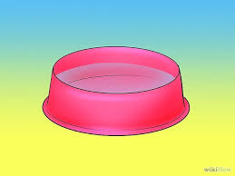
Mass is NEVER lost, it just changes form
(solid, liquid, gas)
Ex. Set a bowl of water outside on a hot day.
The mass of the water in the bowl will get smaller and smaller, but the missing mass is NOT lost.
It is equal to the mass of the water that has evaporated into the air.

Slide 13
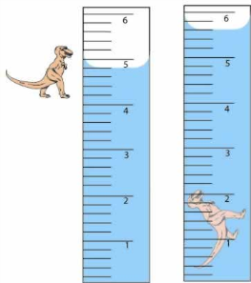
Volume
The amount of space that something takes up.
Volume is measured in two different ways:
Length x width x height and
Water displacement
Examples
A tennis ball takes up more volume or more space than a marble

Slide 14
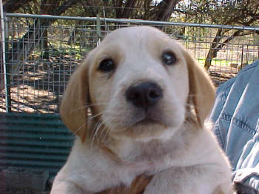
What is density?
Density is a specific property of matter that is related to the mass divided by the volume.

Slide 15
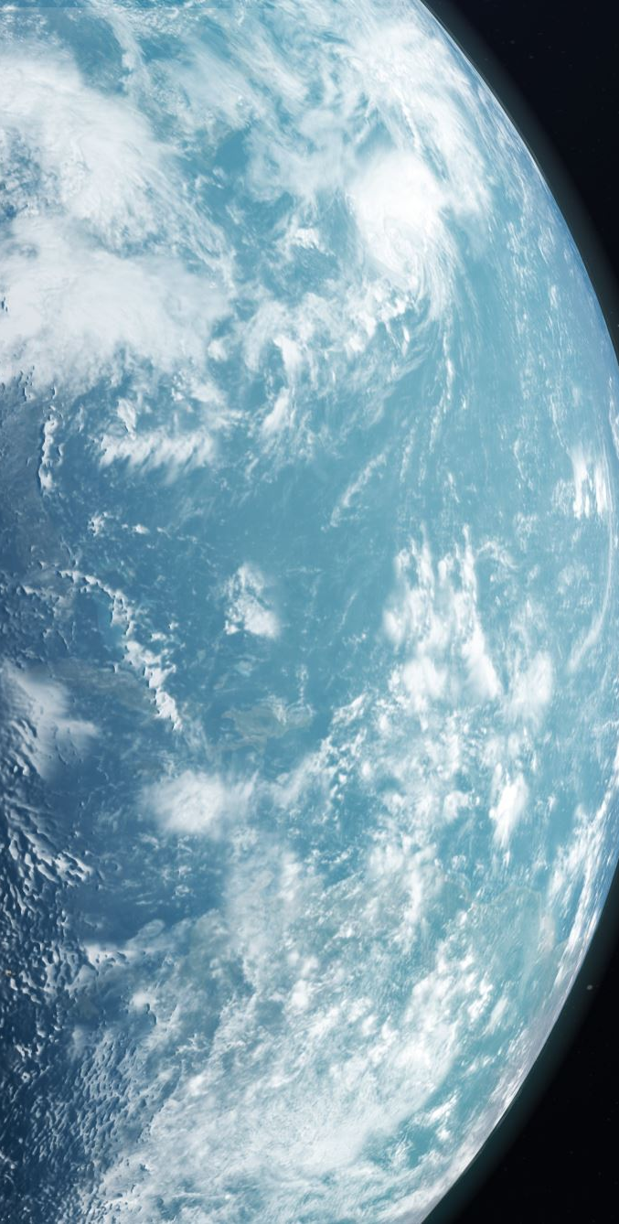
Science Warm Up
09/08/2020
A metal coin has certain properties that can be measured. Which property of a coin is different on the moon than it is on Earth?
mass
weight
volume
density

Slide 16
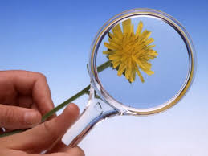
Observing Parts of Matter
Objects and materials are made up of smaller parts that can be too small to see with your eyes. You must magnify, or make them appear larger than they are.

Slide 17
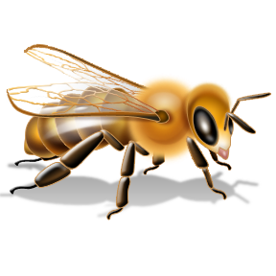

Hand Lens
A hand lens is one tool that makes small objects appear larger. You can use this to see the parts of small object.
Ex. To see the tiny hairs that covers a bees back, or the veins of a leaf.

Slide 18
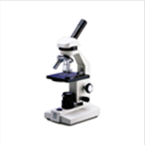
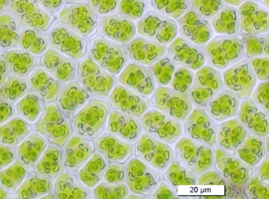
Microscope
A microscope is a tool that makes tiny objects appears much larger.
Ex. to see tiny parts such as the cells that make up a leaf.

Slide 19
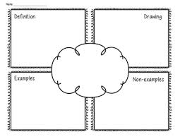
Create a frayer diagram that explains the word “Matter”

Slide 20
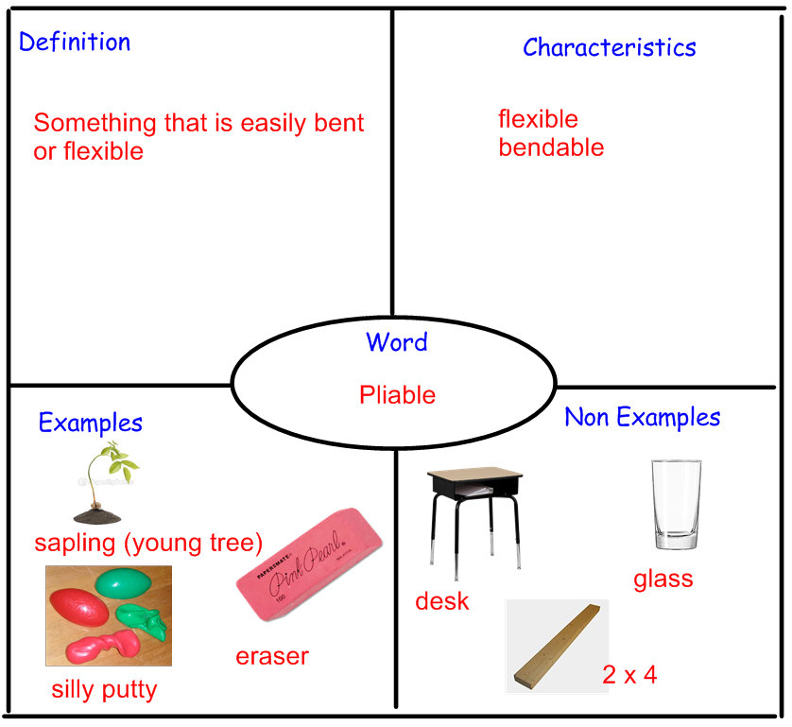
Sample Frayer

Slide 21


